Slide 2
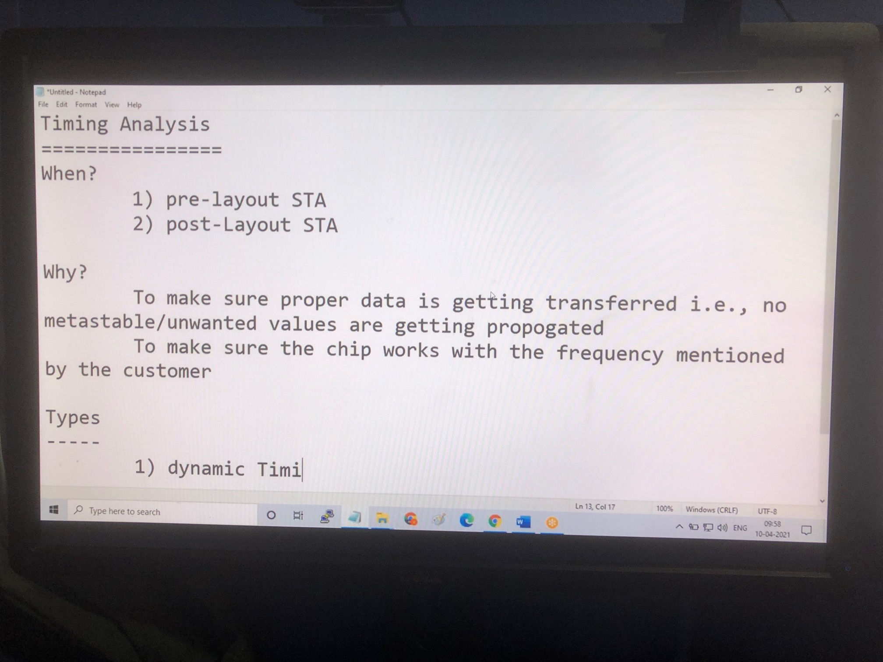

Slide 3
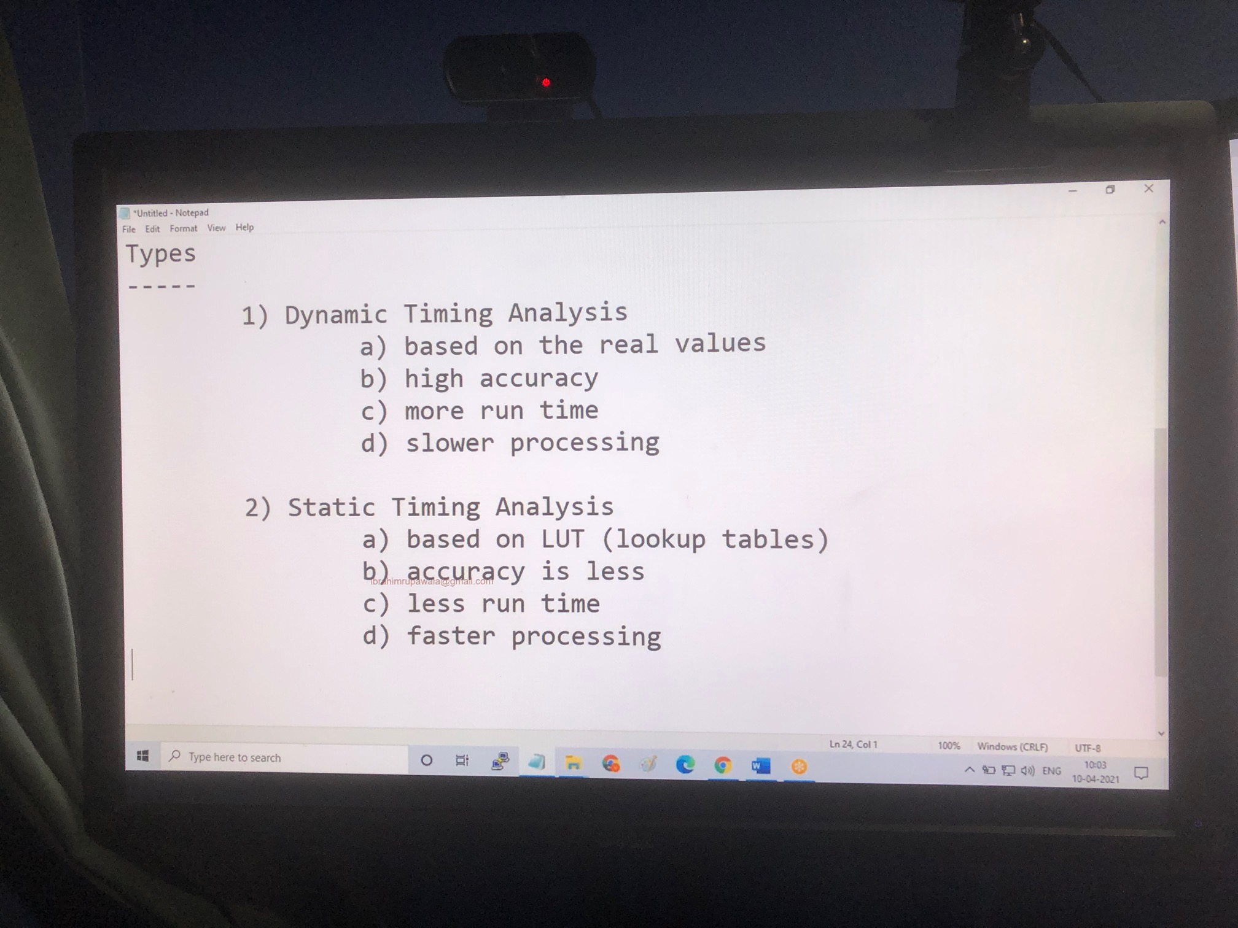

Slide 4
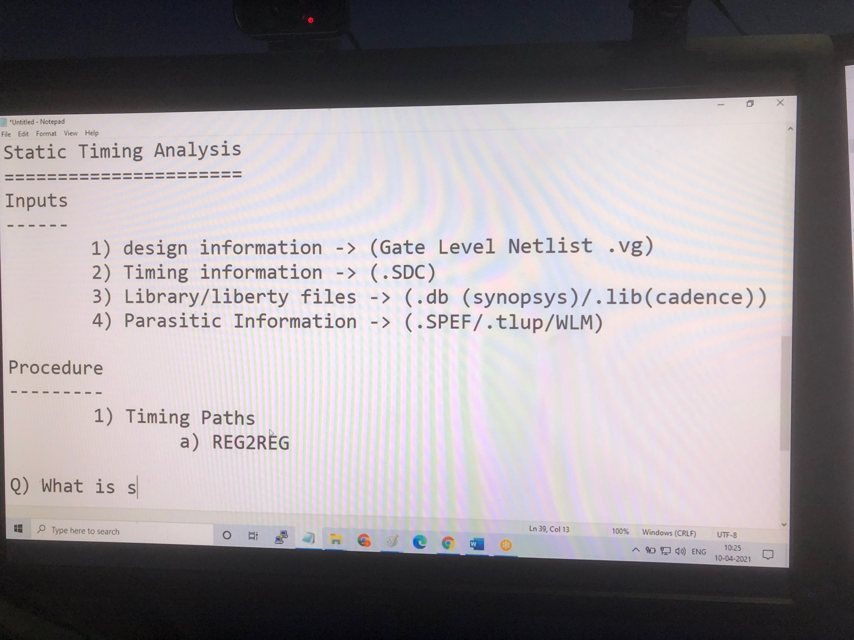

Slide 5
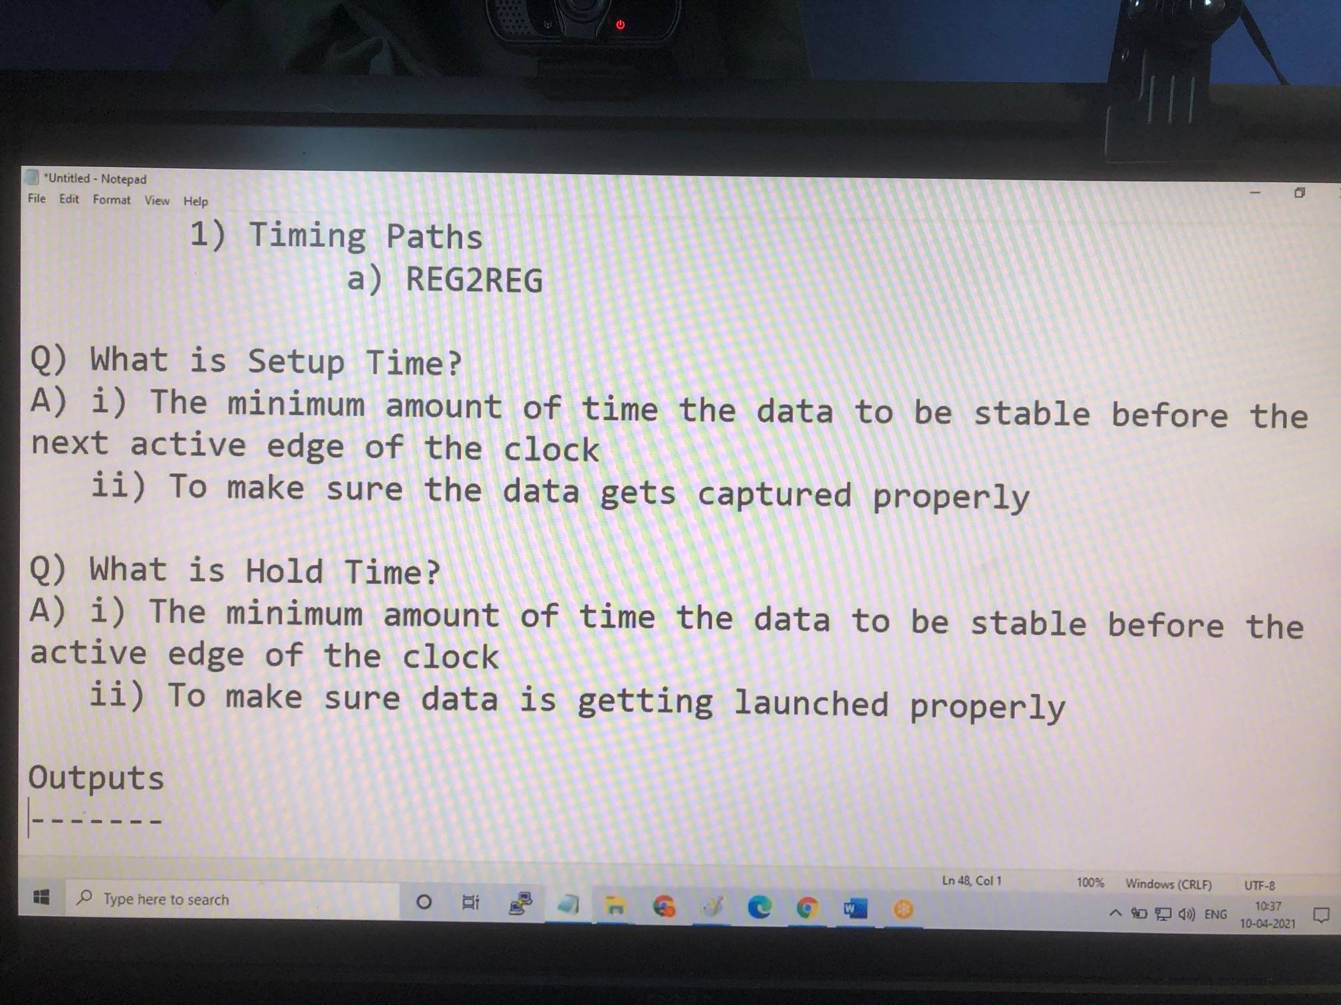

Slide 6
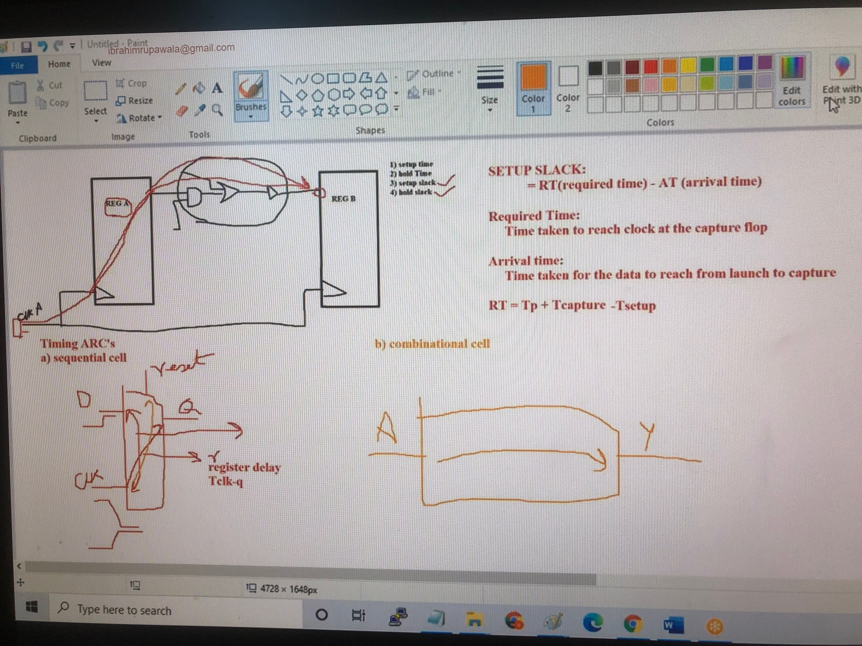

Slide 7
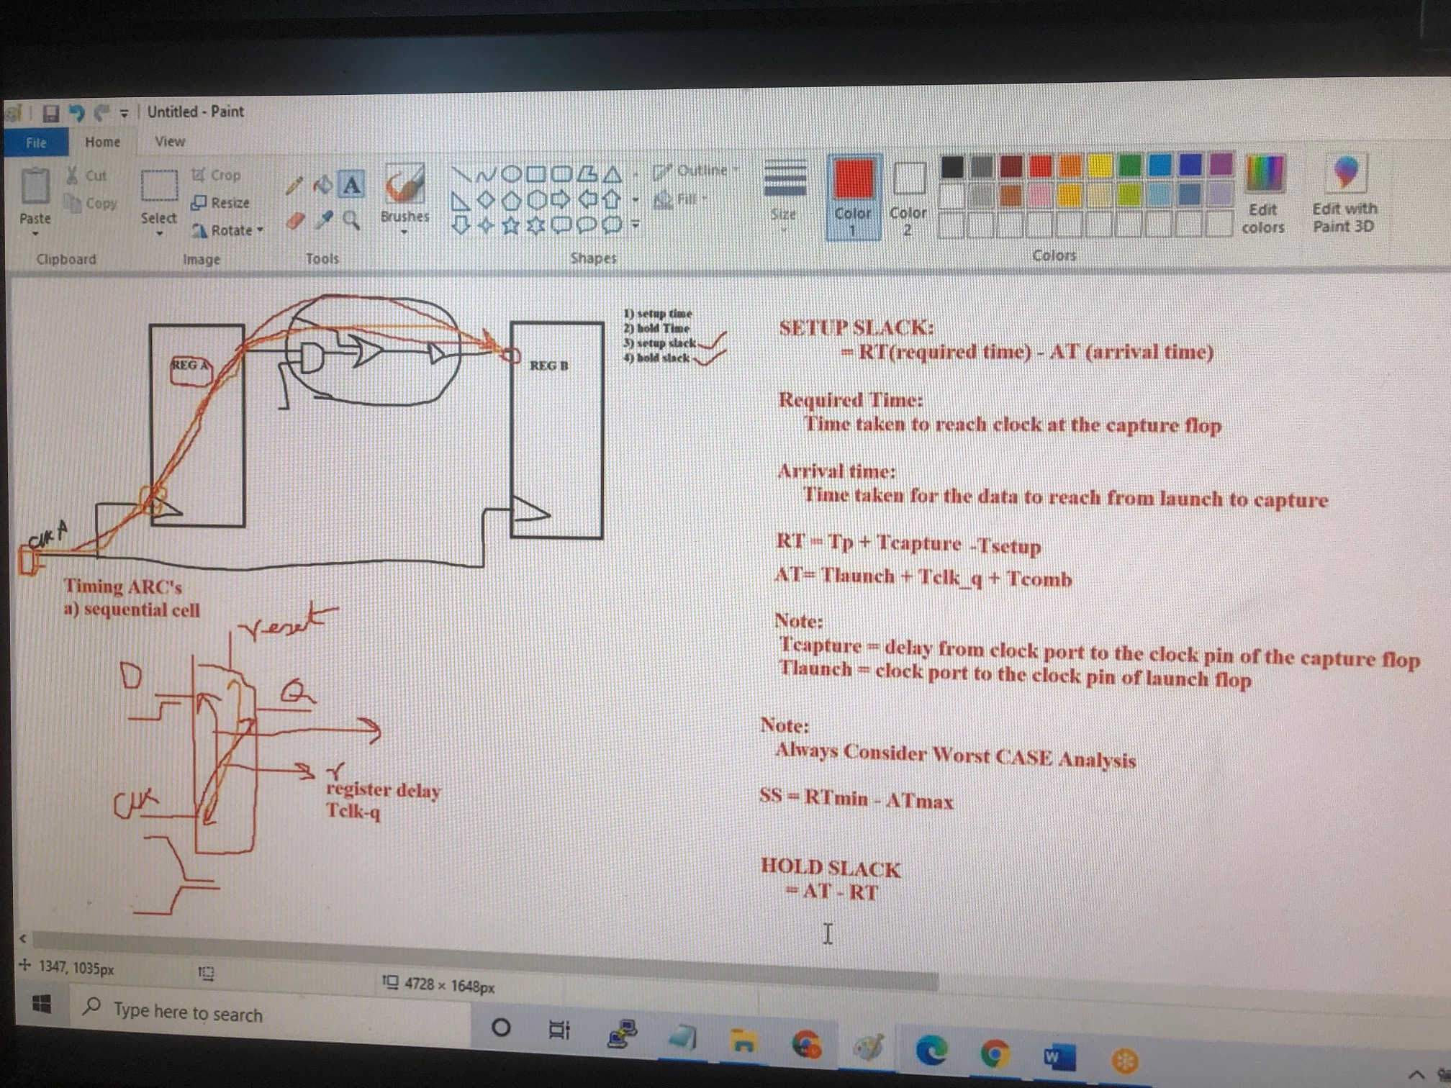

Slide 8
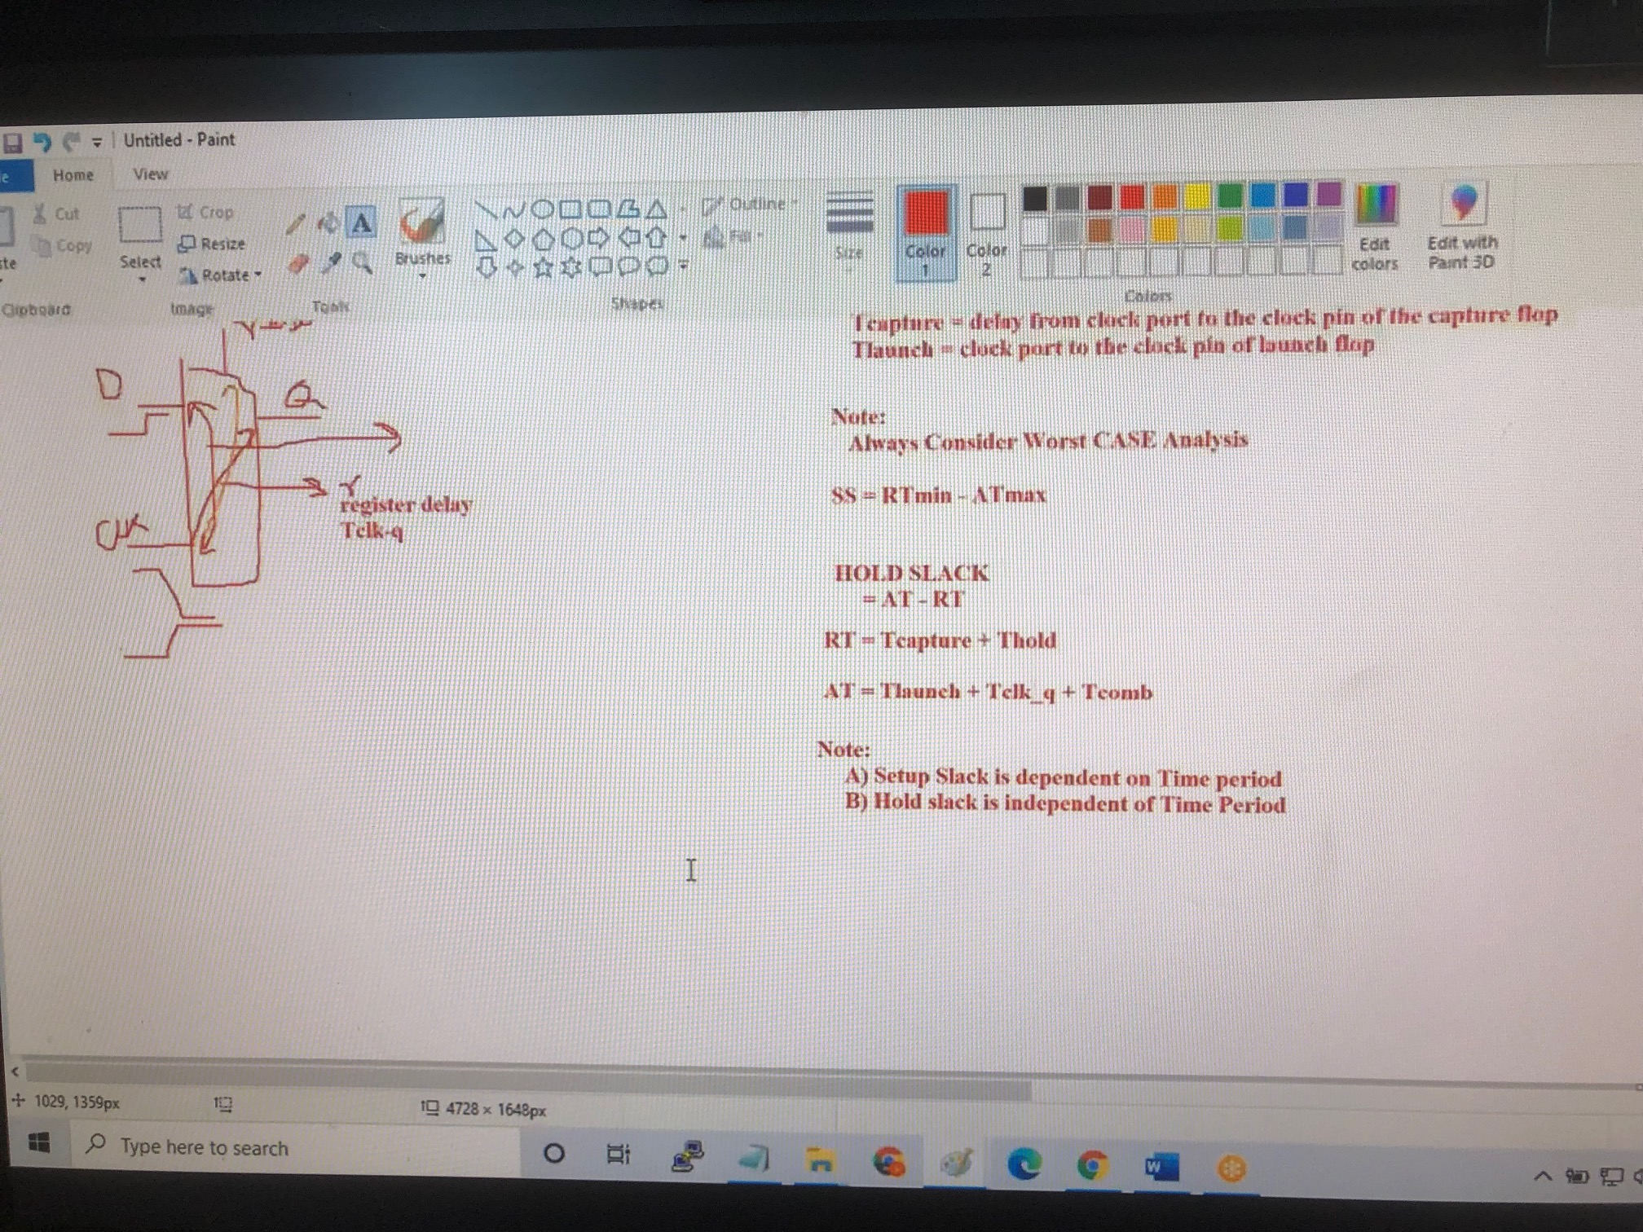

Slide 9
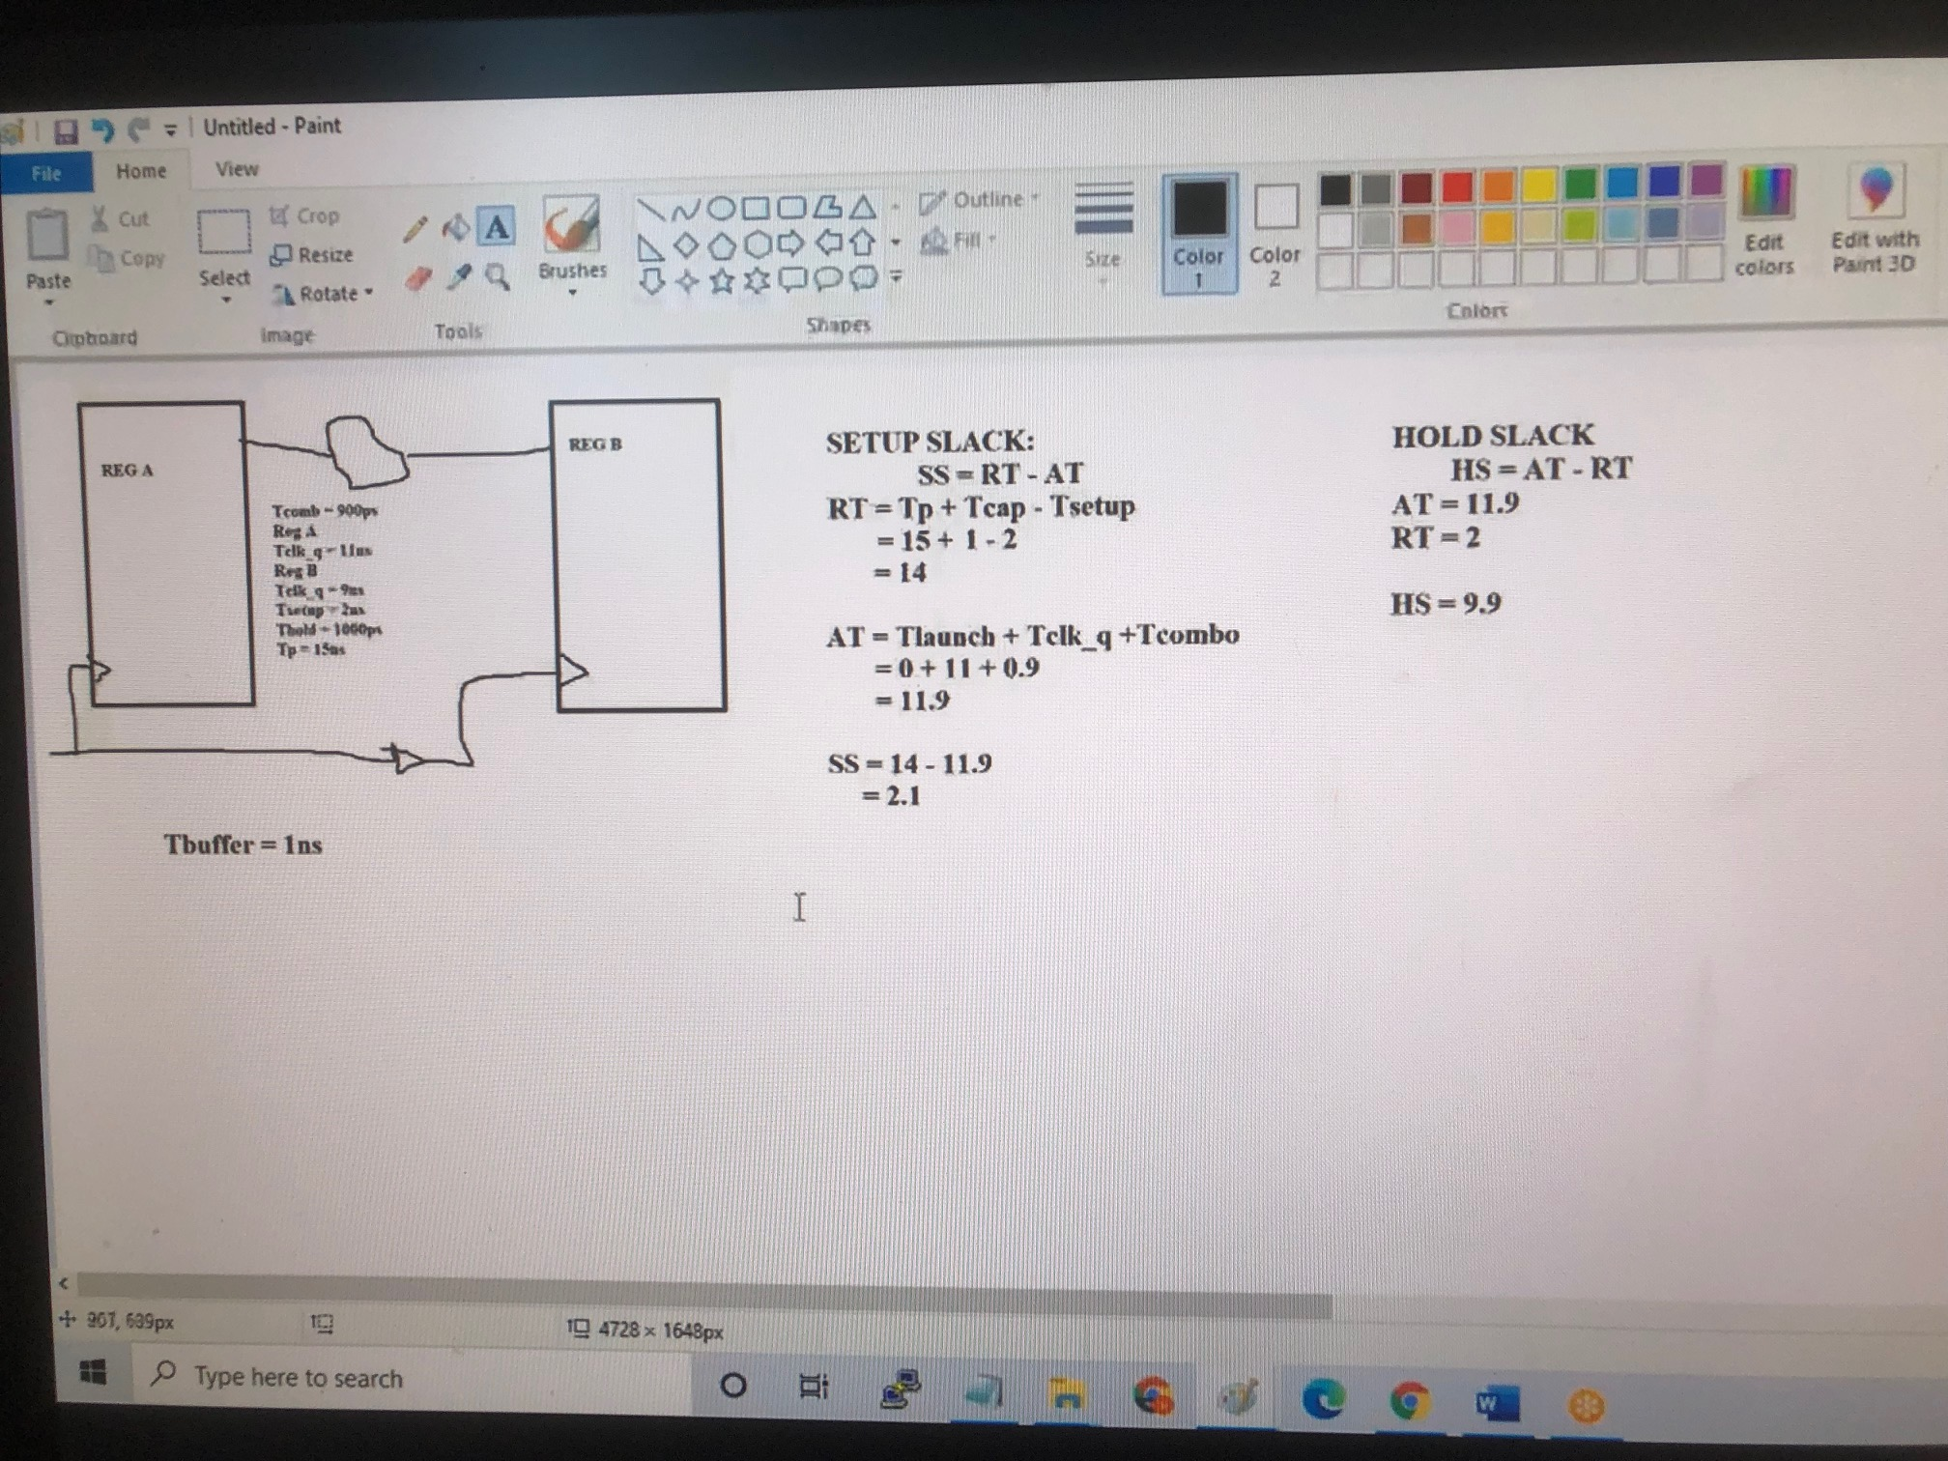

Slide 10
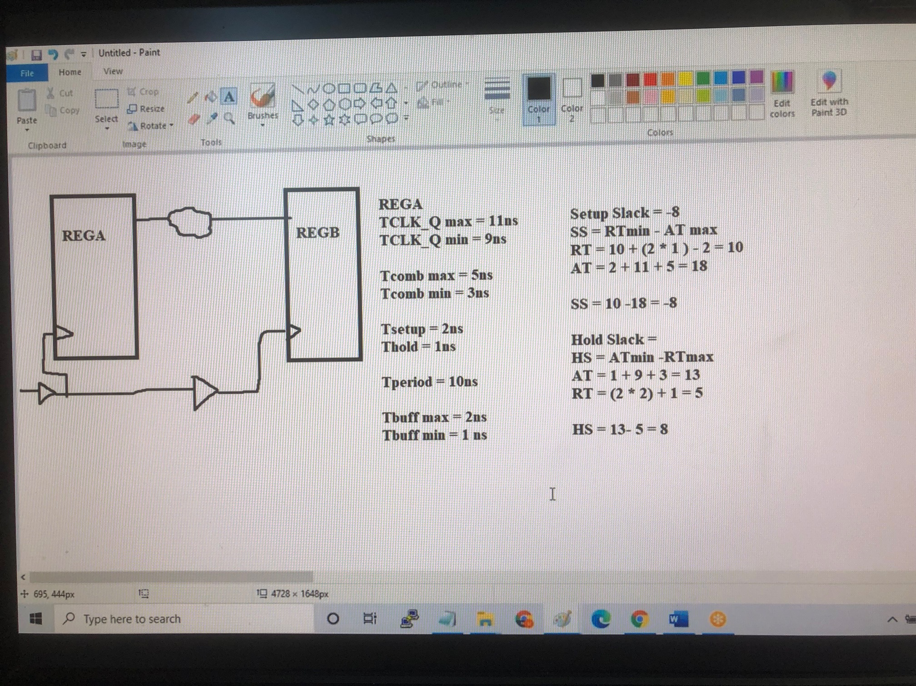

Slide 11
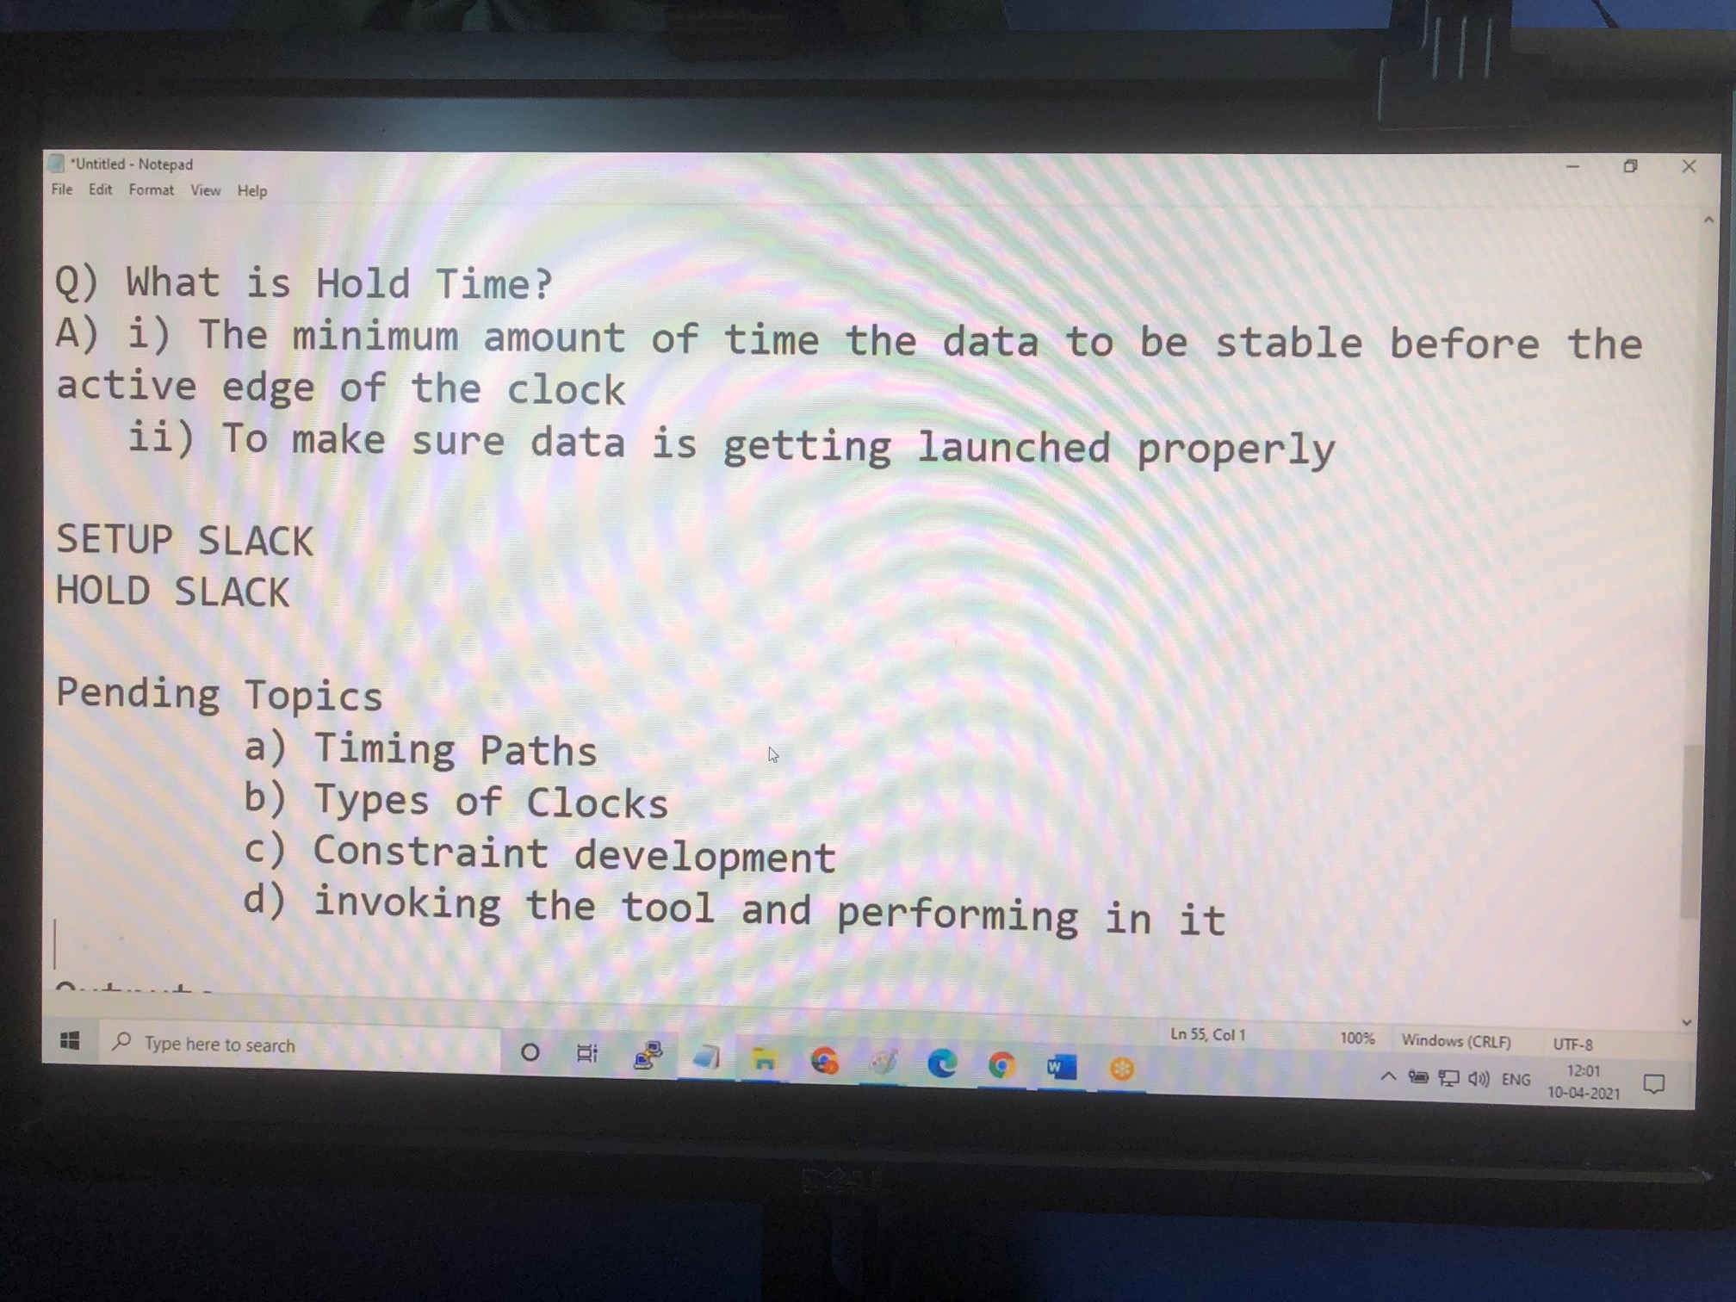

Slide 12
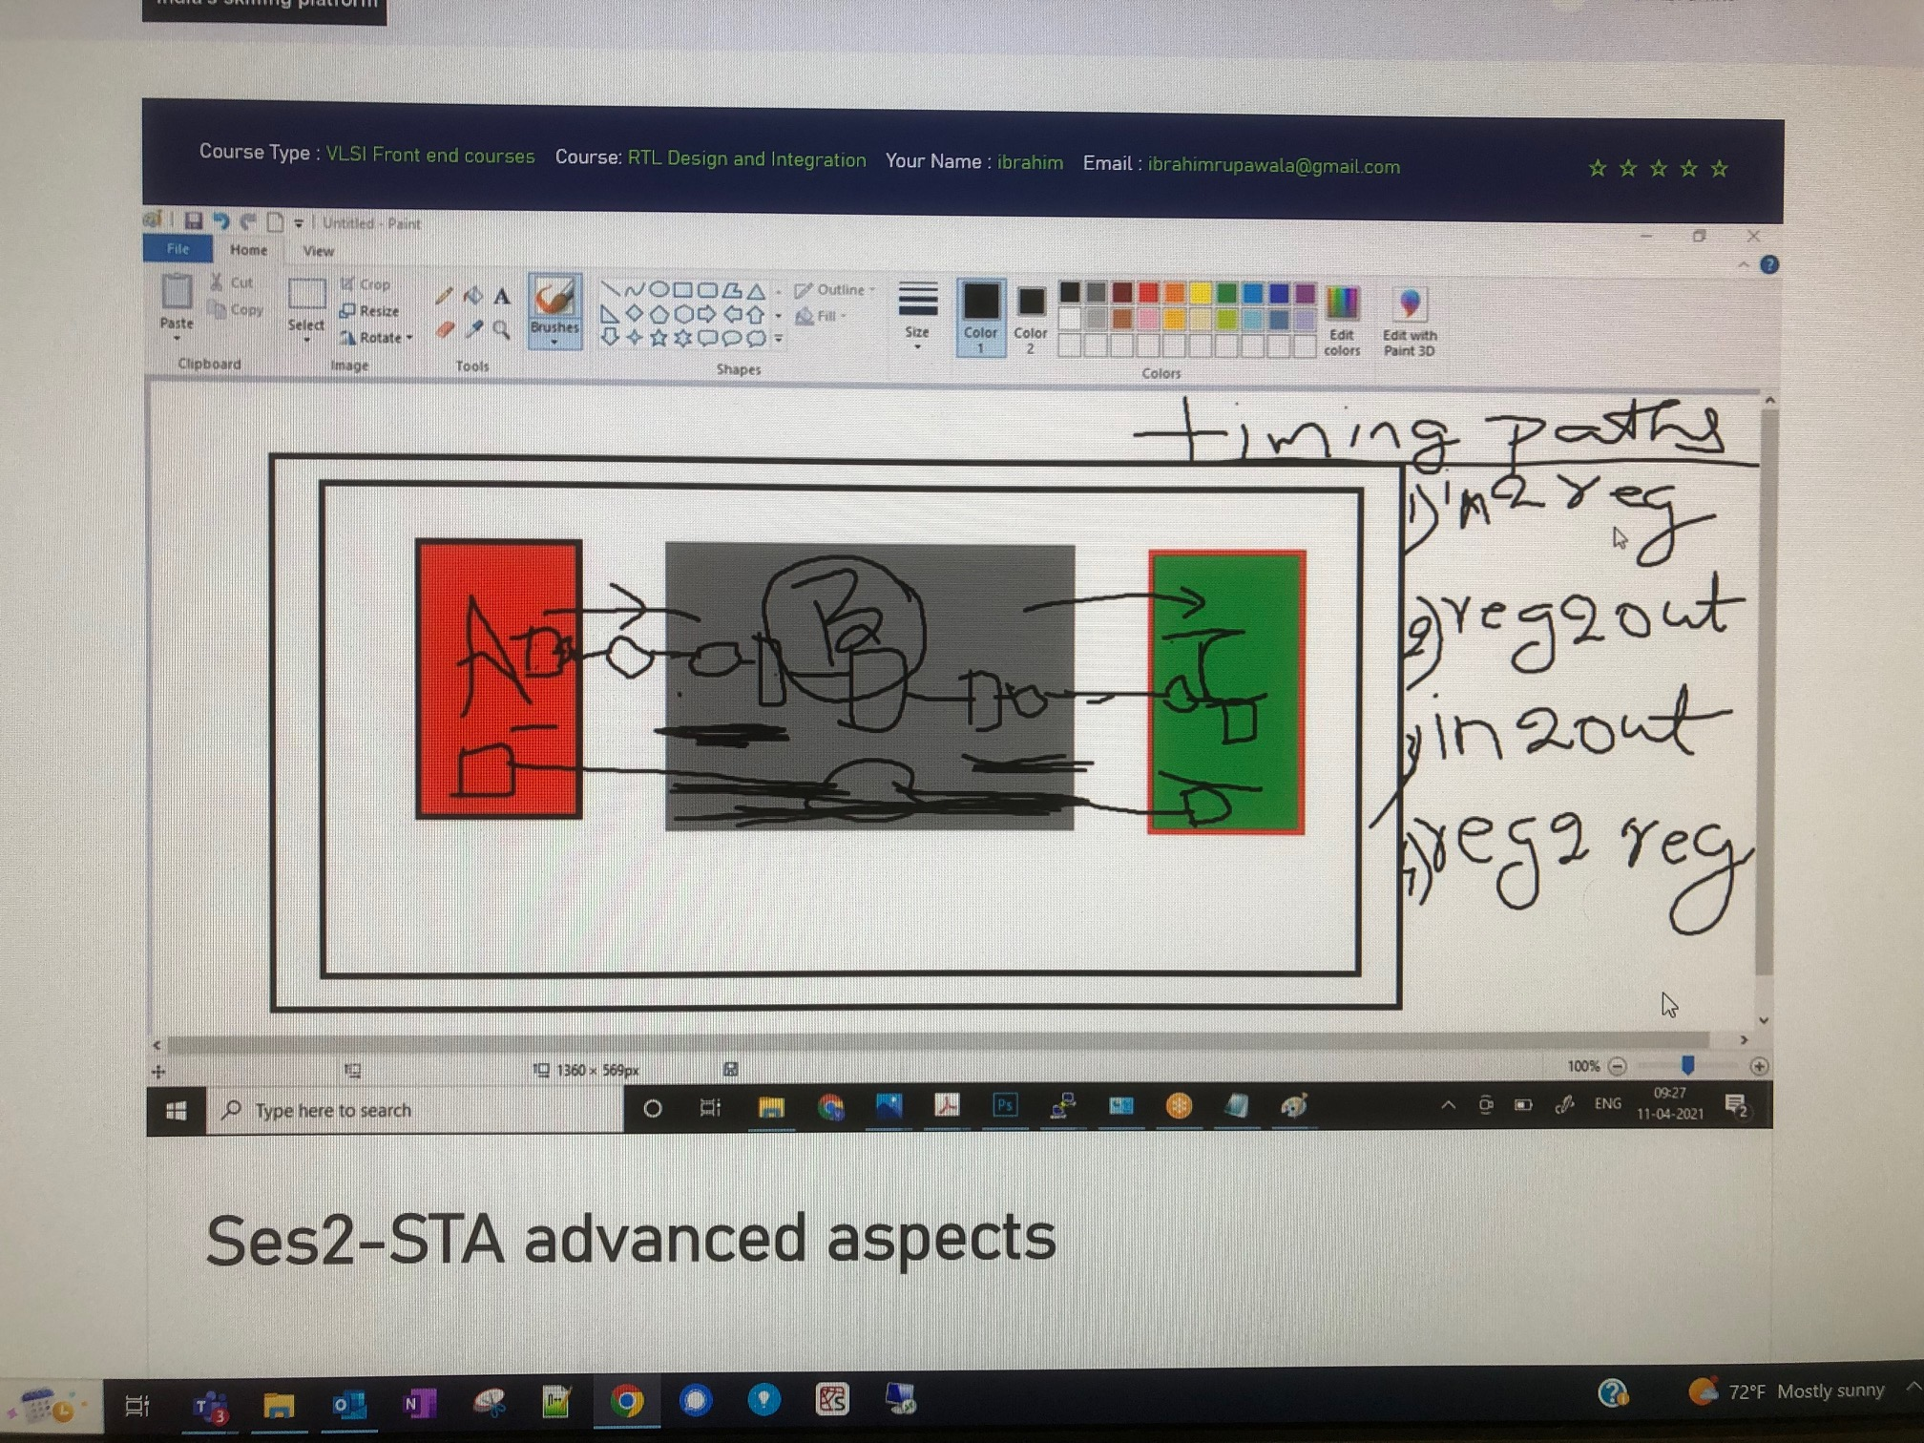

Slide 13
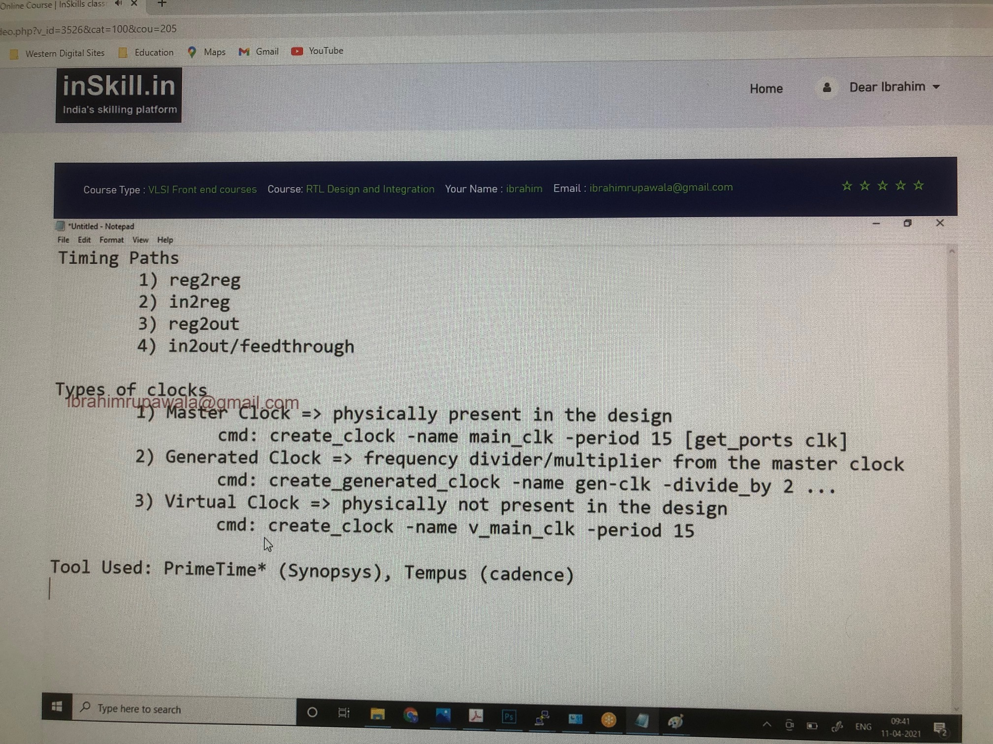

Slide 14
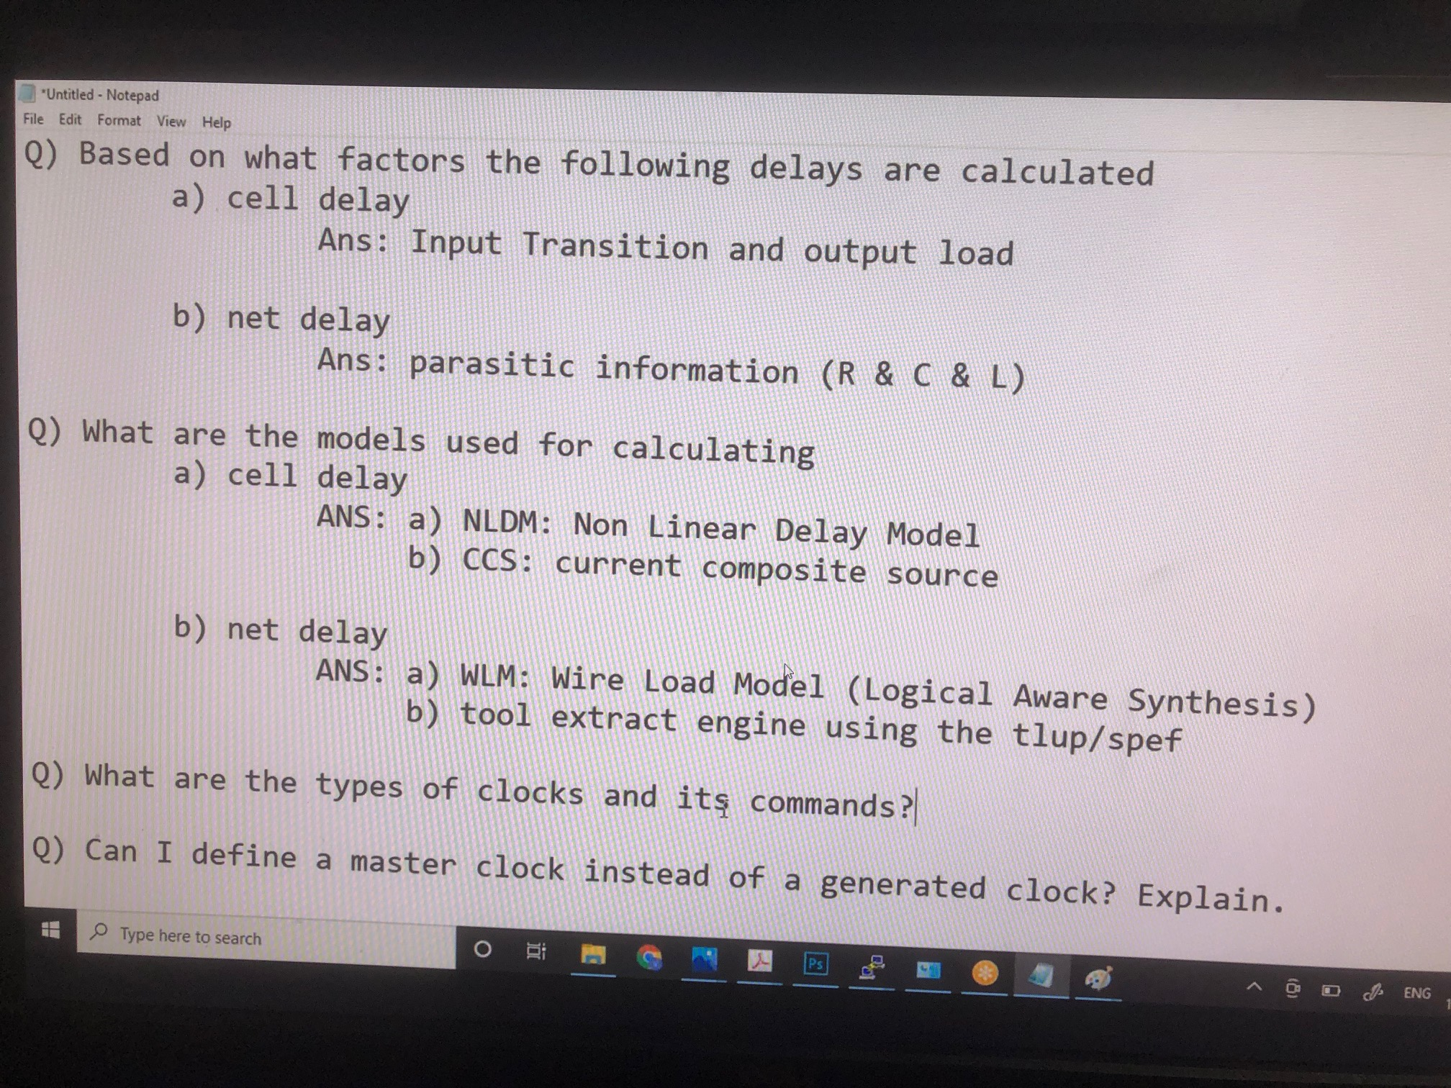

Slide 15
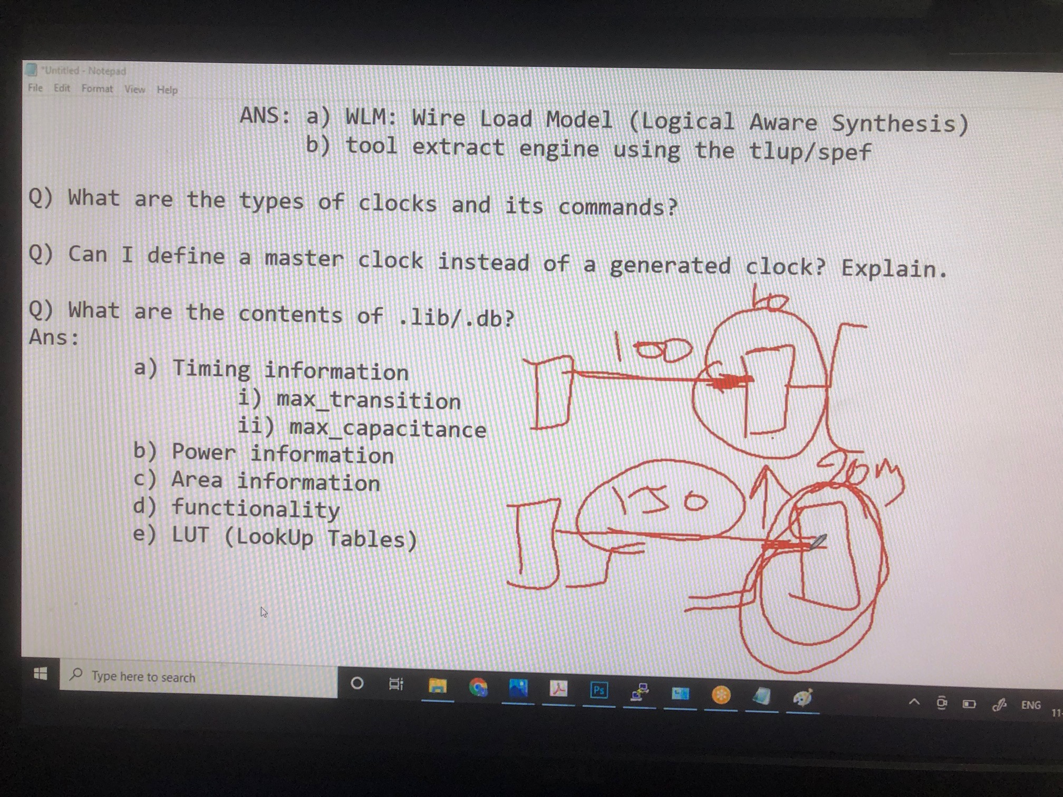

Slide 16
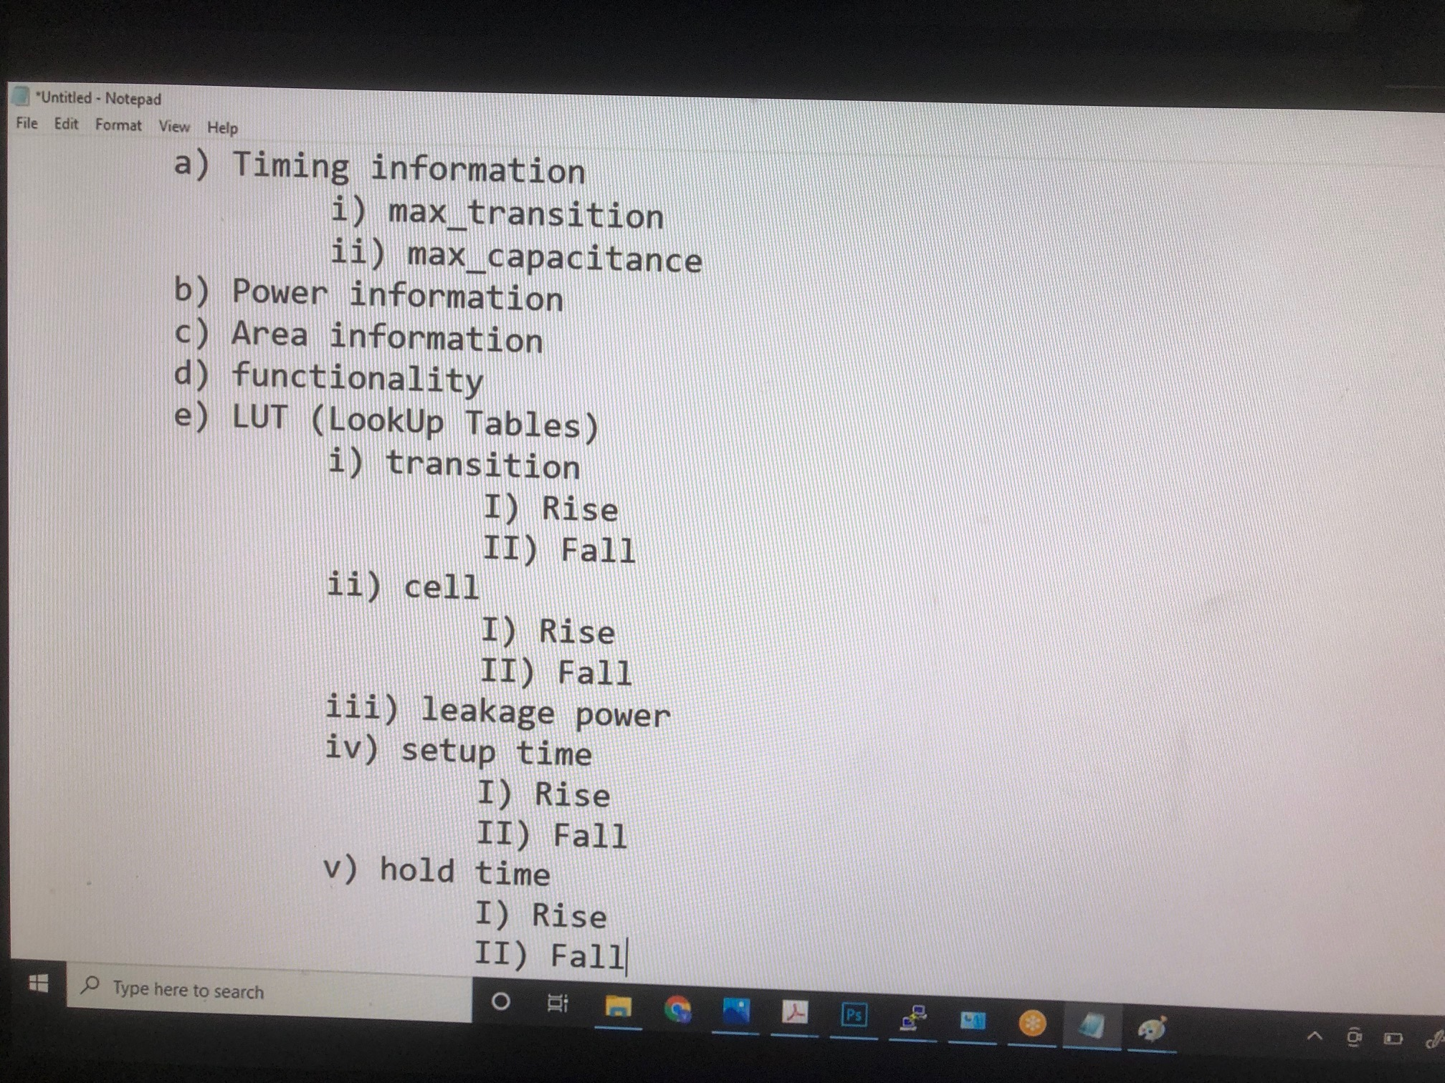

Slide 17
.lib or .db is having standard cells information of each and every macro in your design.
For each and every pin, the timing information available is max_transition and max_capacitance
Lookup tables are having the tables which
Cell delay is considered based on
1. input transition and
2. output load.
Input transition high means to convert from 0 to 1 it is taking more time. If input transition is more then cell delay will also be high. Hence lookup table (LUT) contains the mapping of cell delay to the different values of input transition and output load.
Non-Linear Delay Model (NLDM) is a voltage based model while Current Composite Source (CCS) is a Current based Model. NLDM is approximate model while for CCS accuracy is high
Wire load model as seen in db_nldm file also has different values (ForQA), based on these different delay model values, one can tell which particular delay calculation style we want to use
Operating_conditions (ss0p75v125c) shows on which particular PVT corner was this .lib file created.

Slide 18
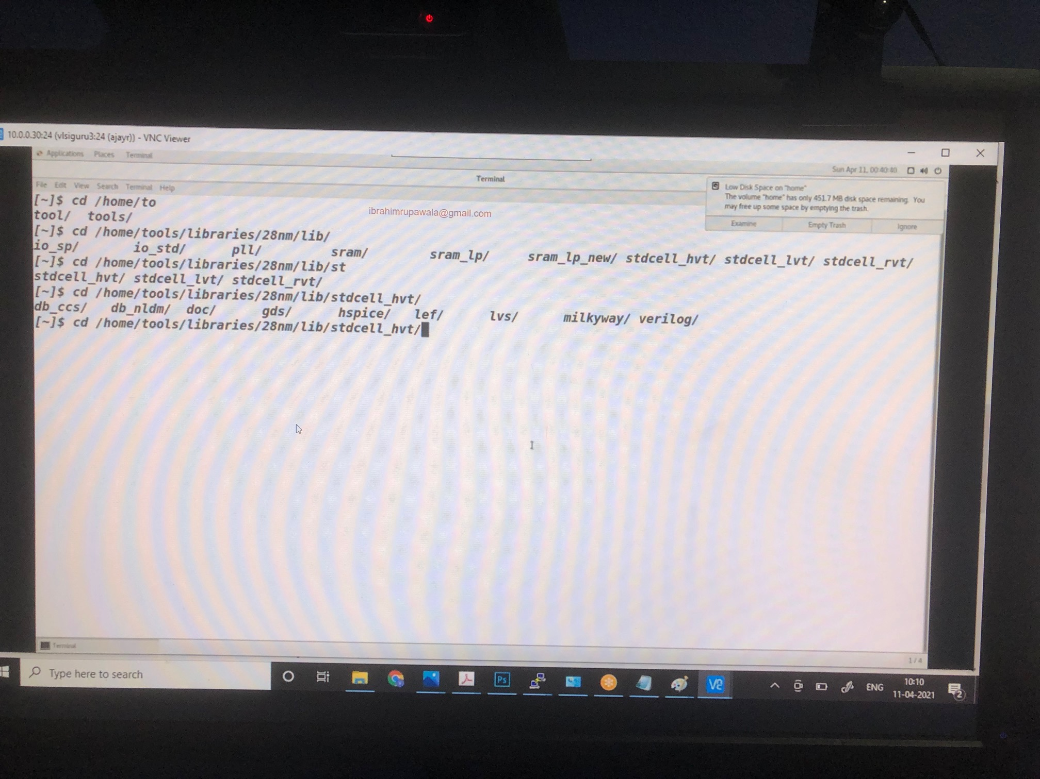

Slide 19
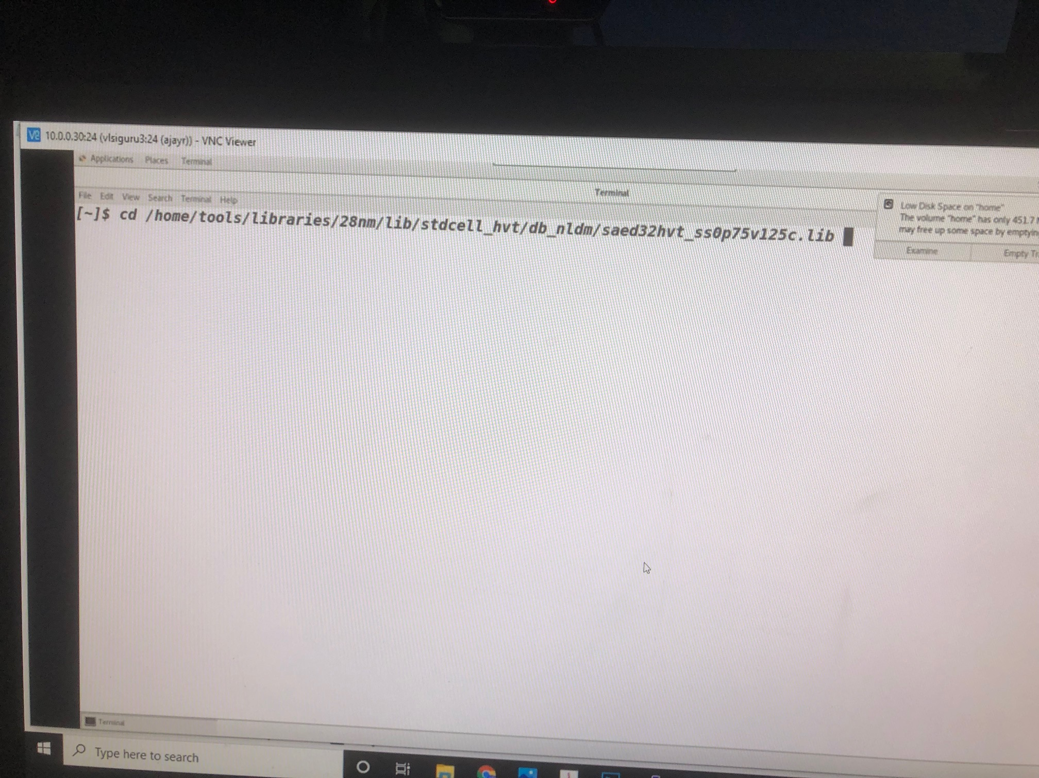

Slide 20
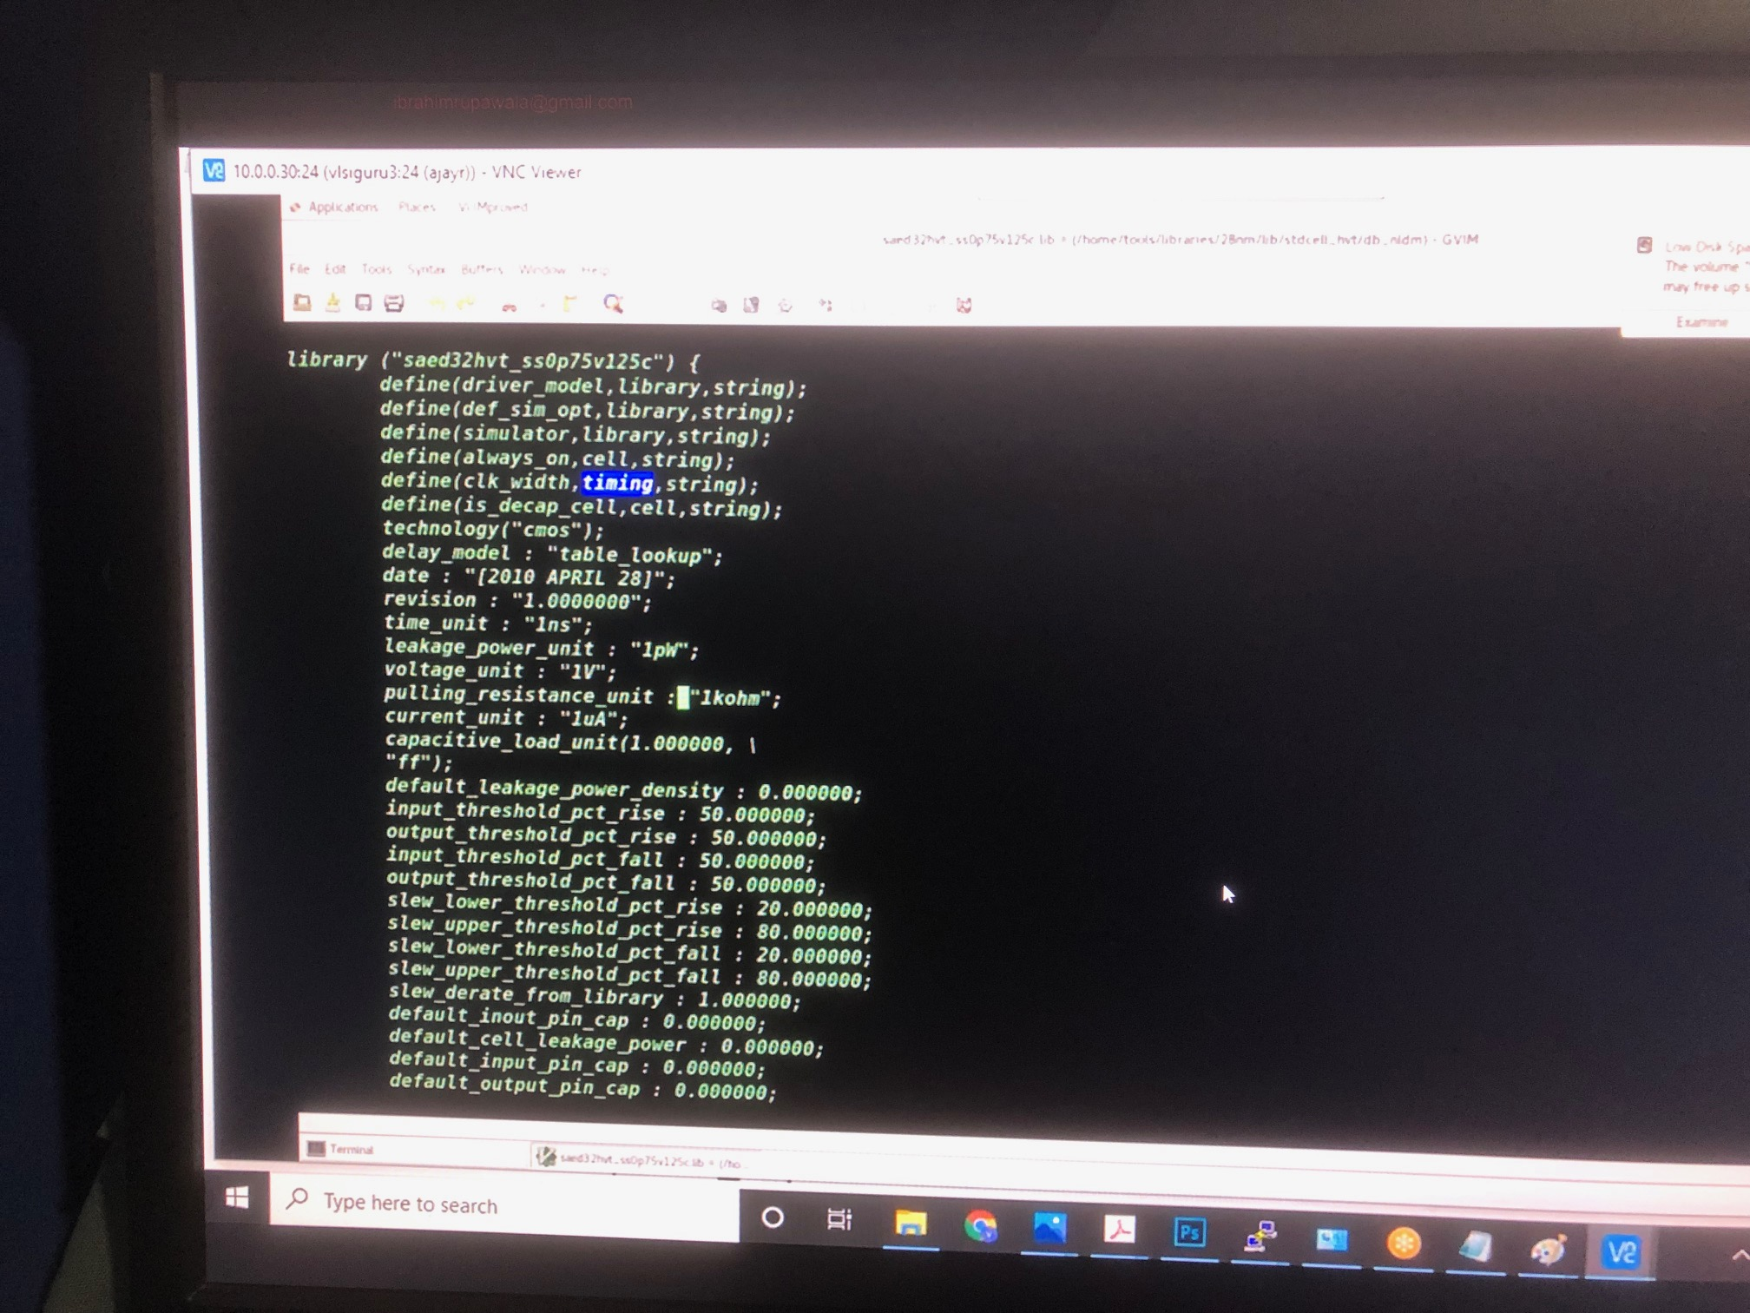

Slide 21
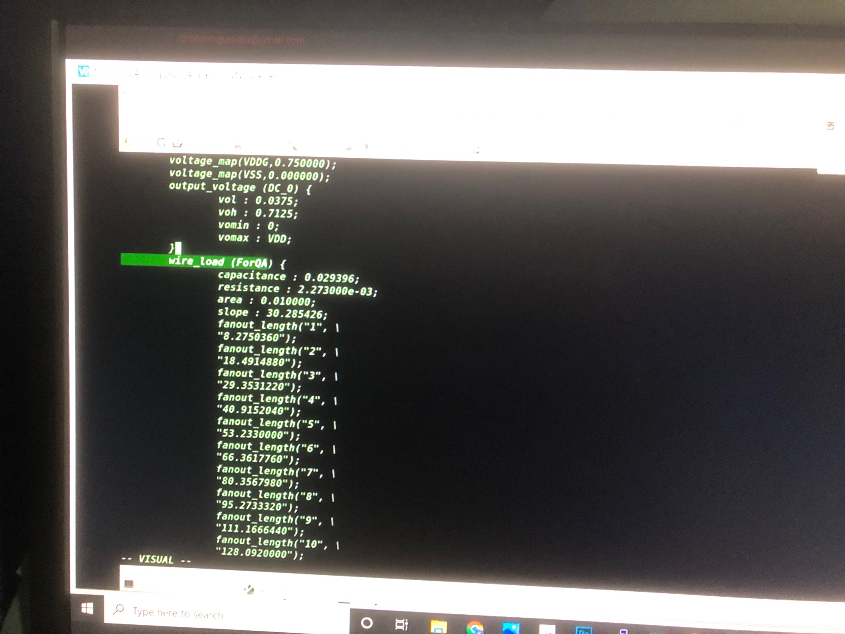

Slide 22
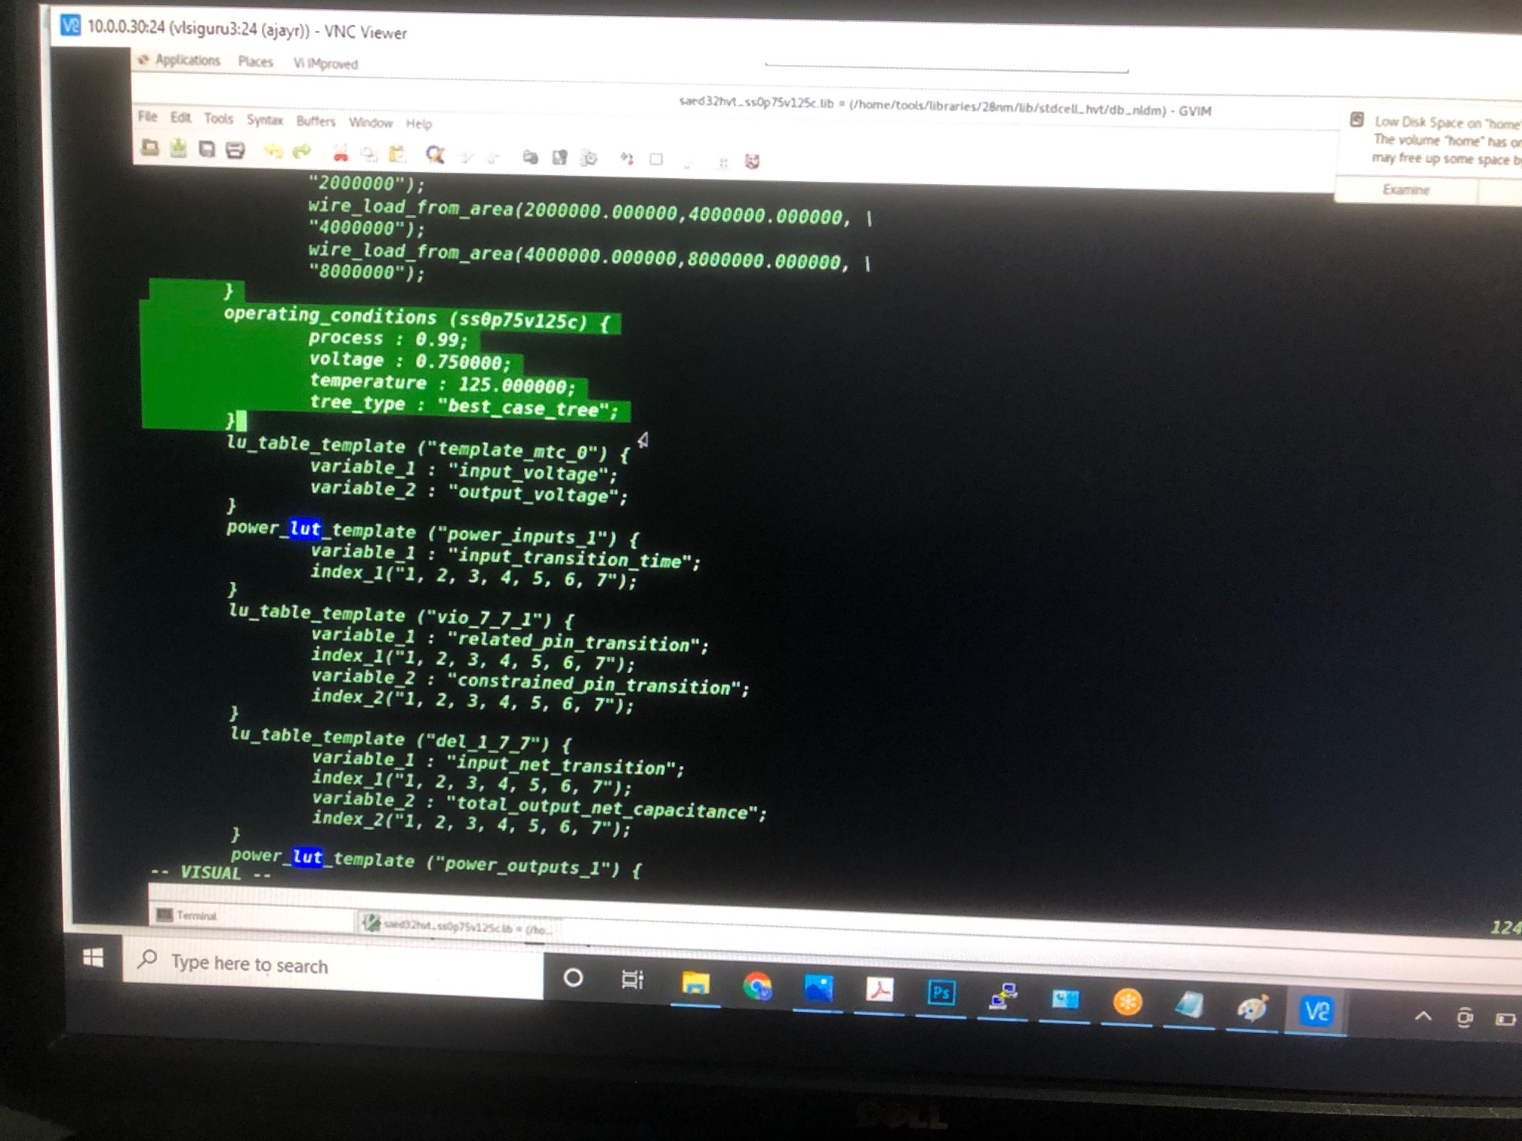

Slide 23
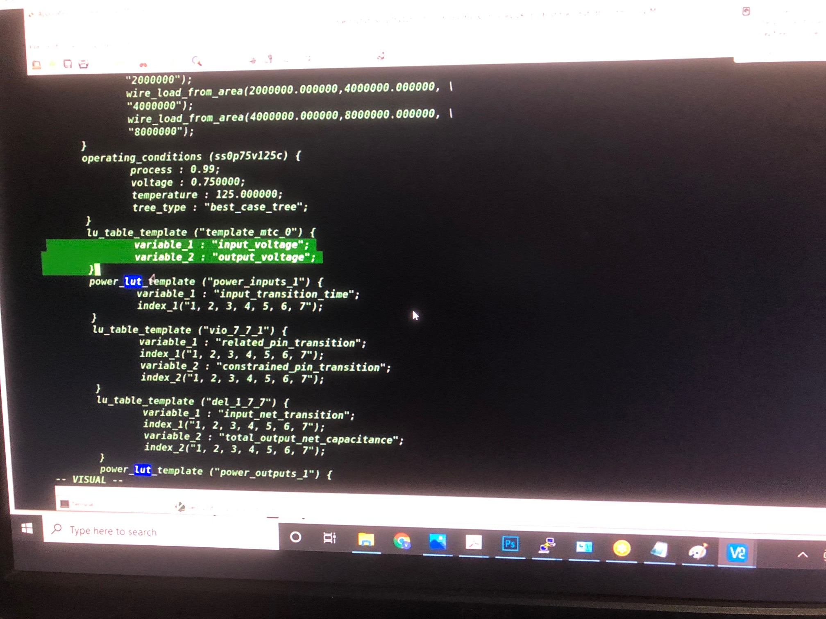

Slide 24
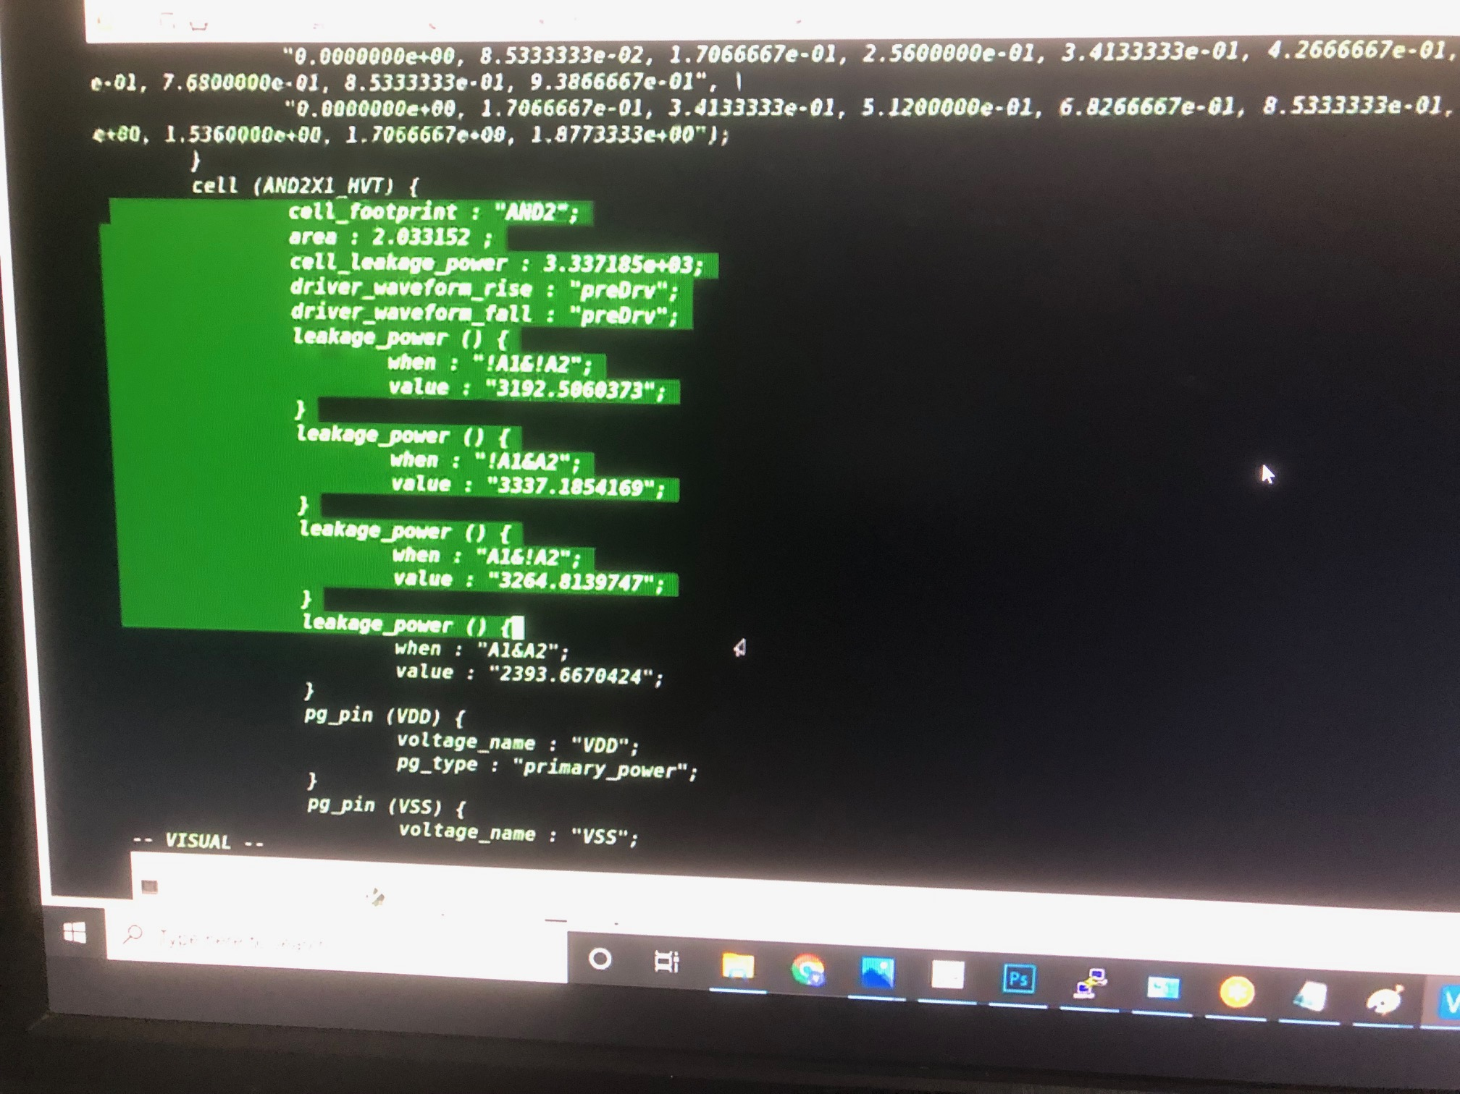

Slide 25
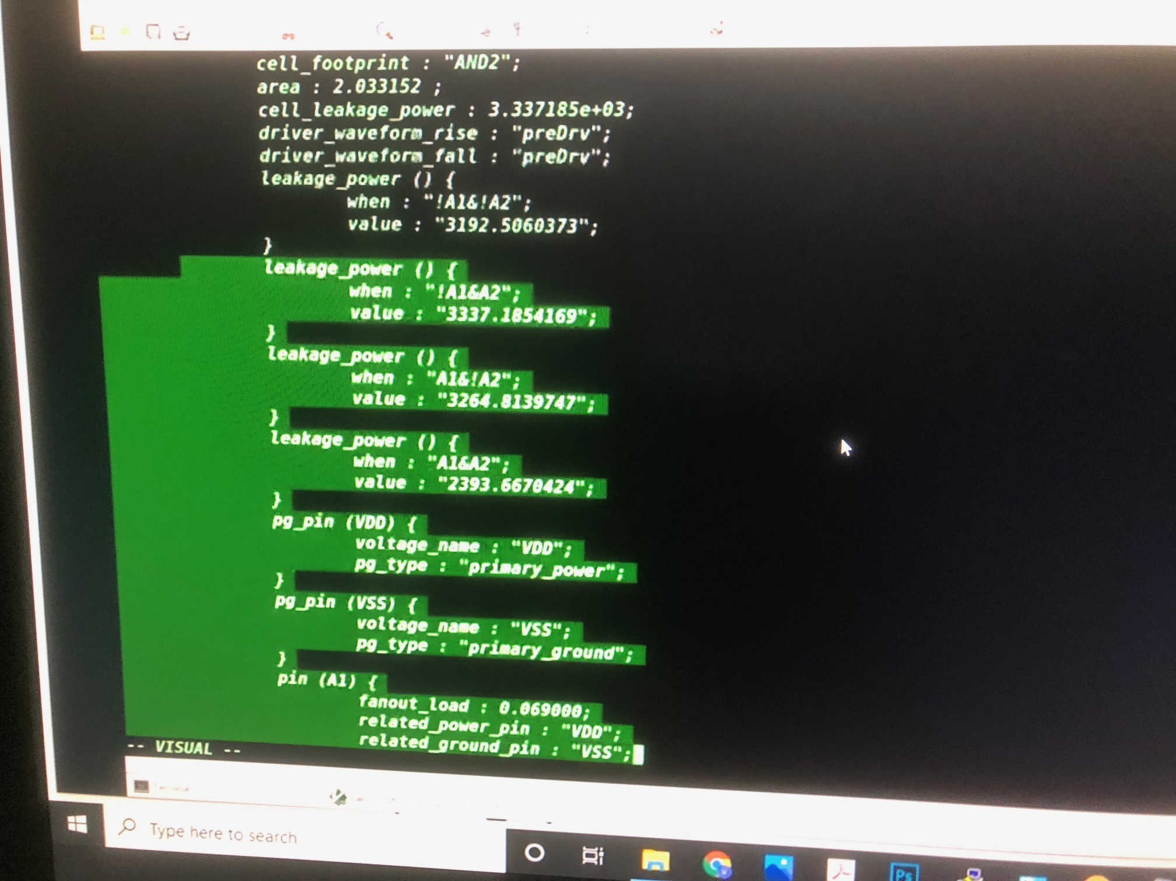

Slide 26
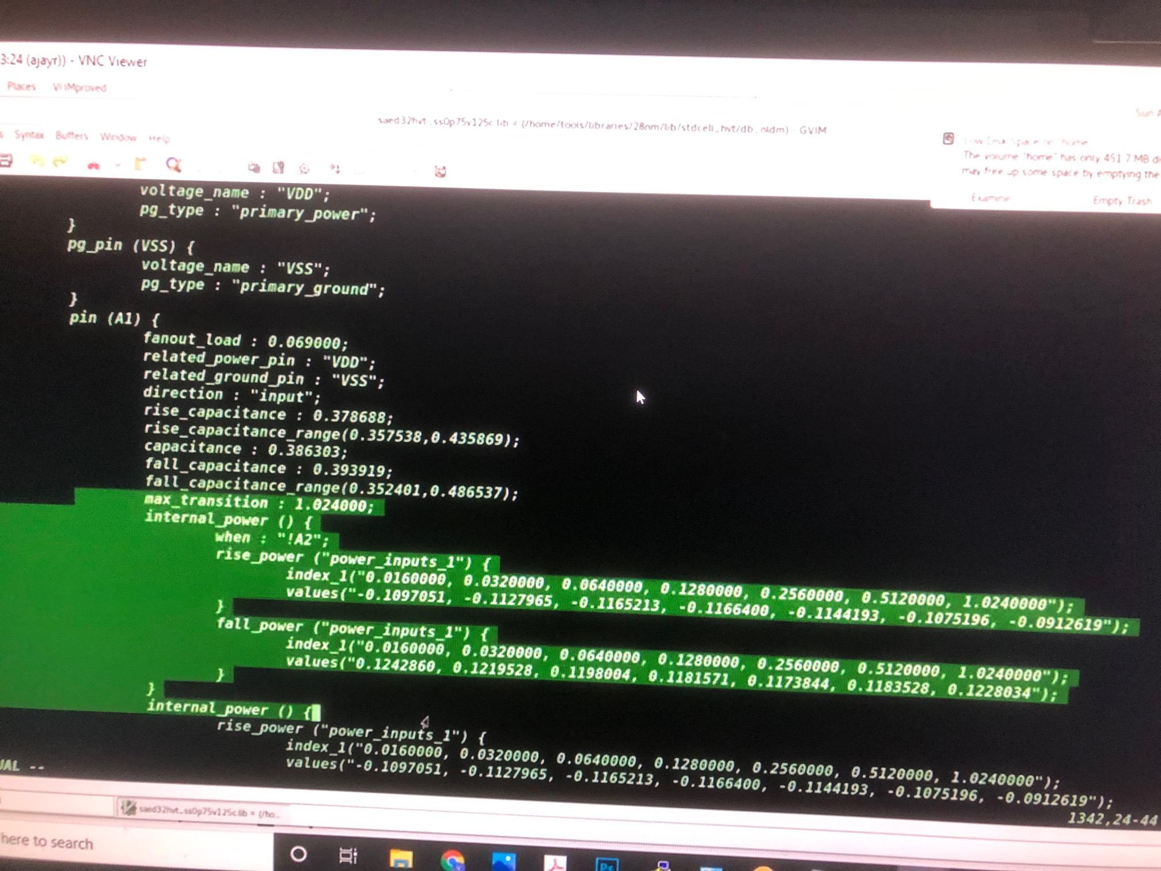

Slide 27
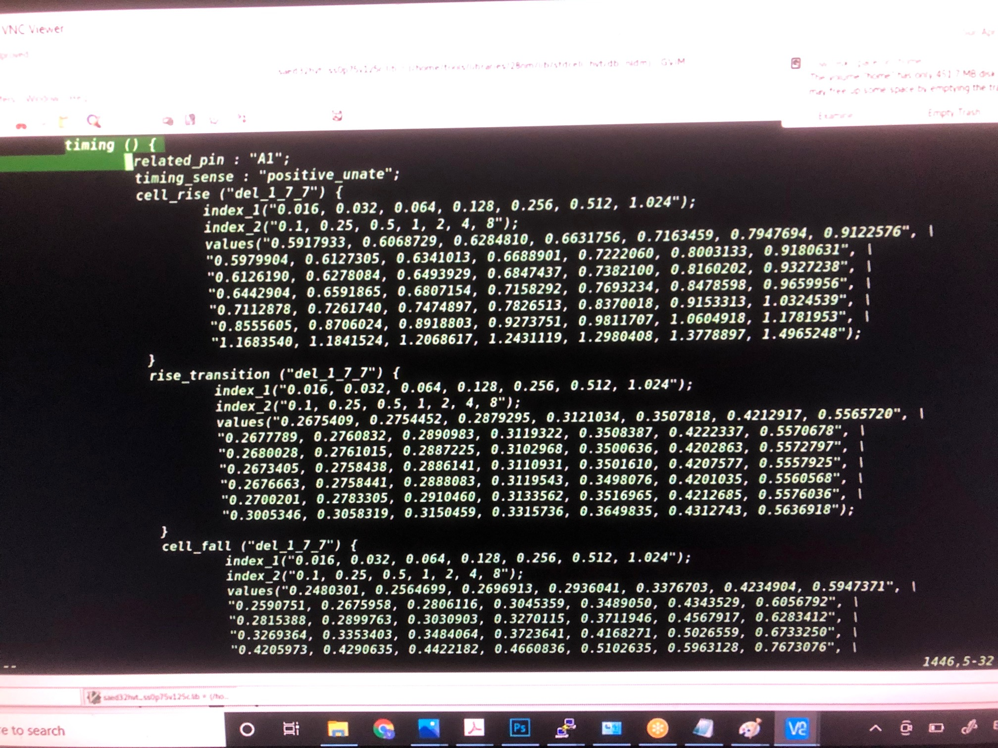

Slide 28
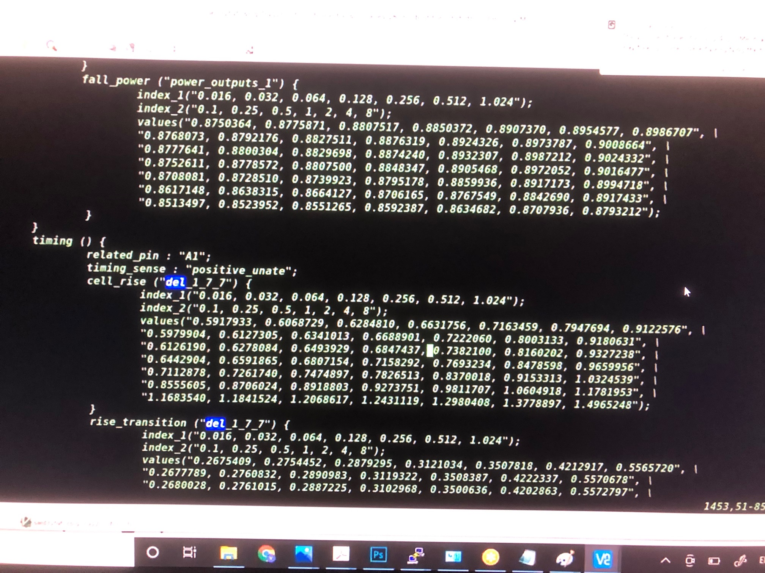

Slide 29
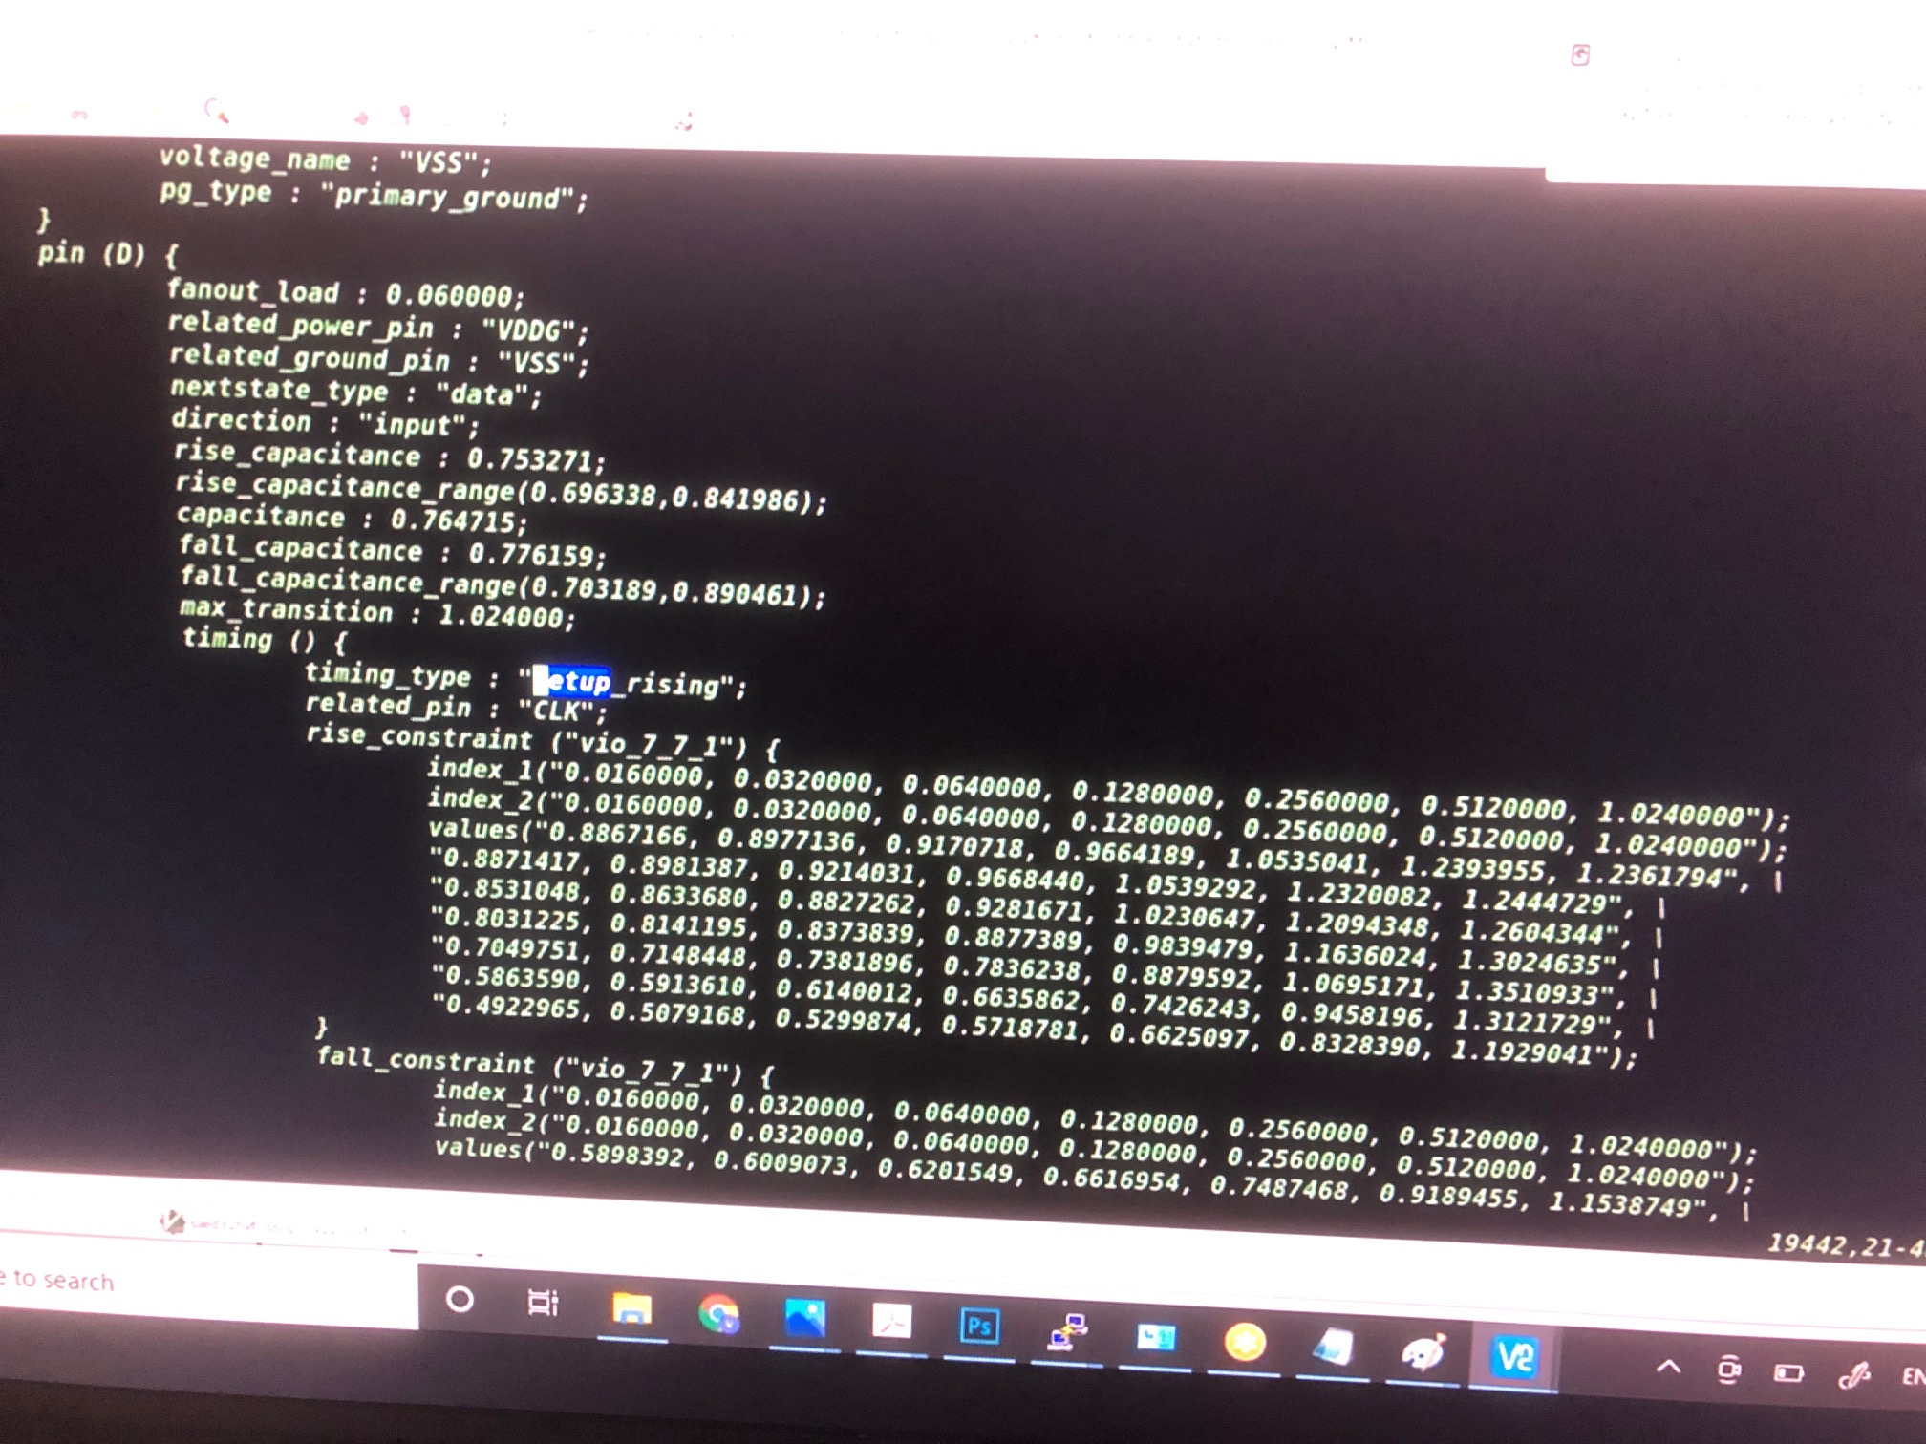

Slide 30
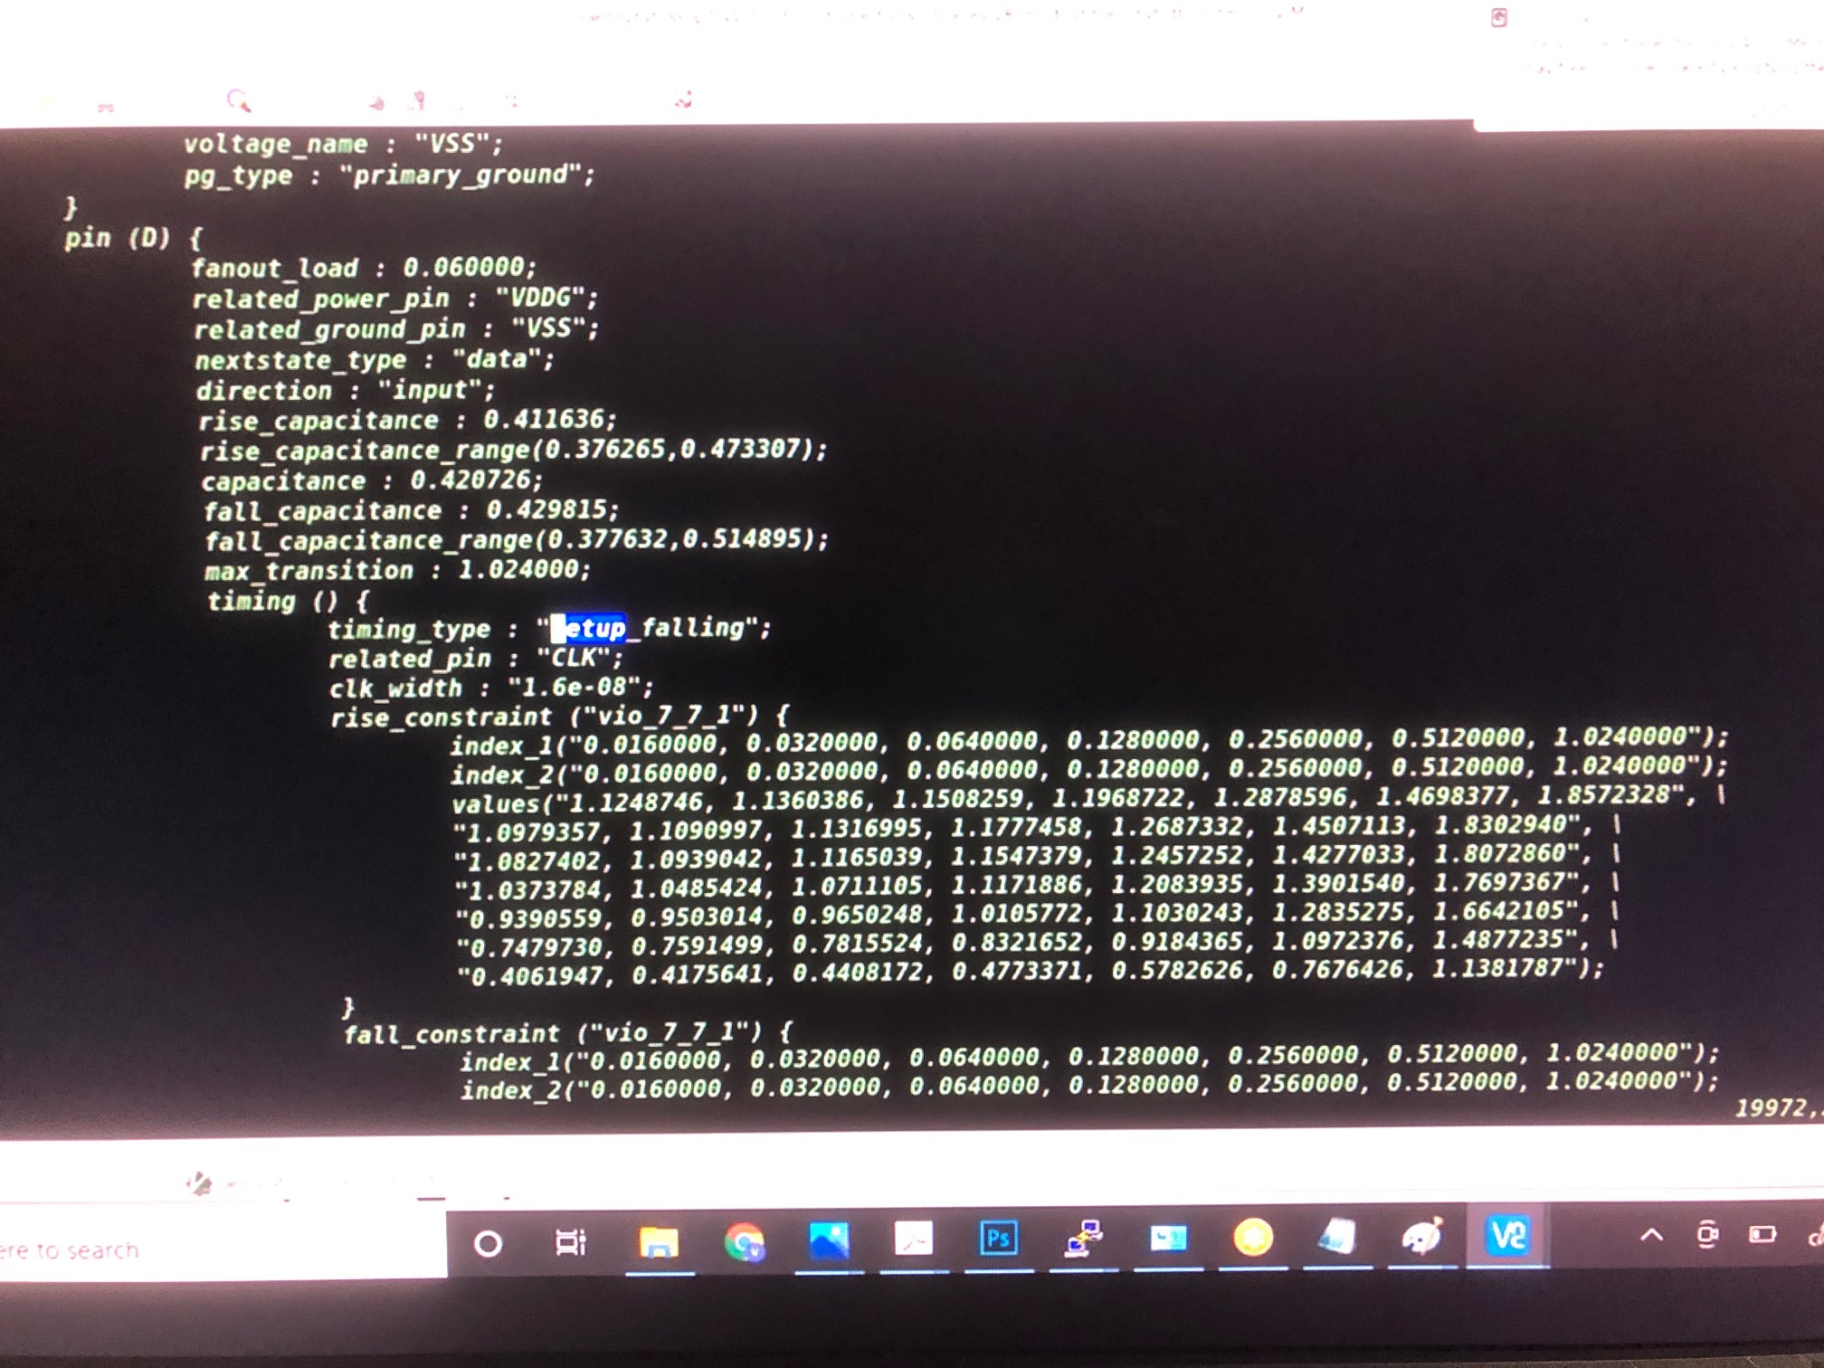

Slide 31
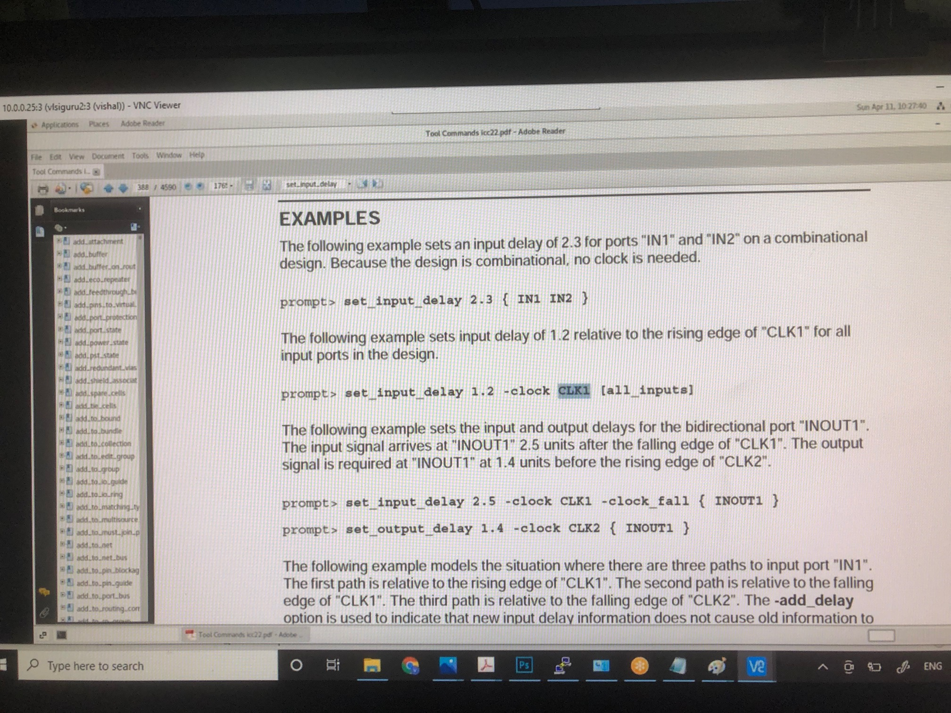

Slide 32
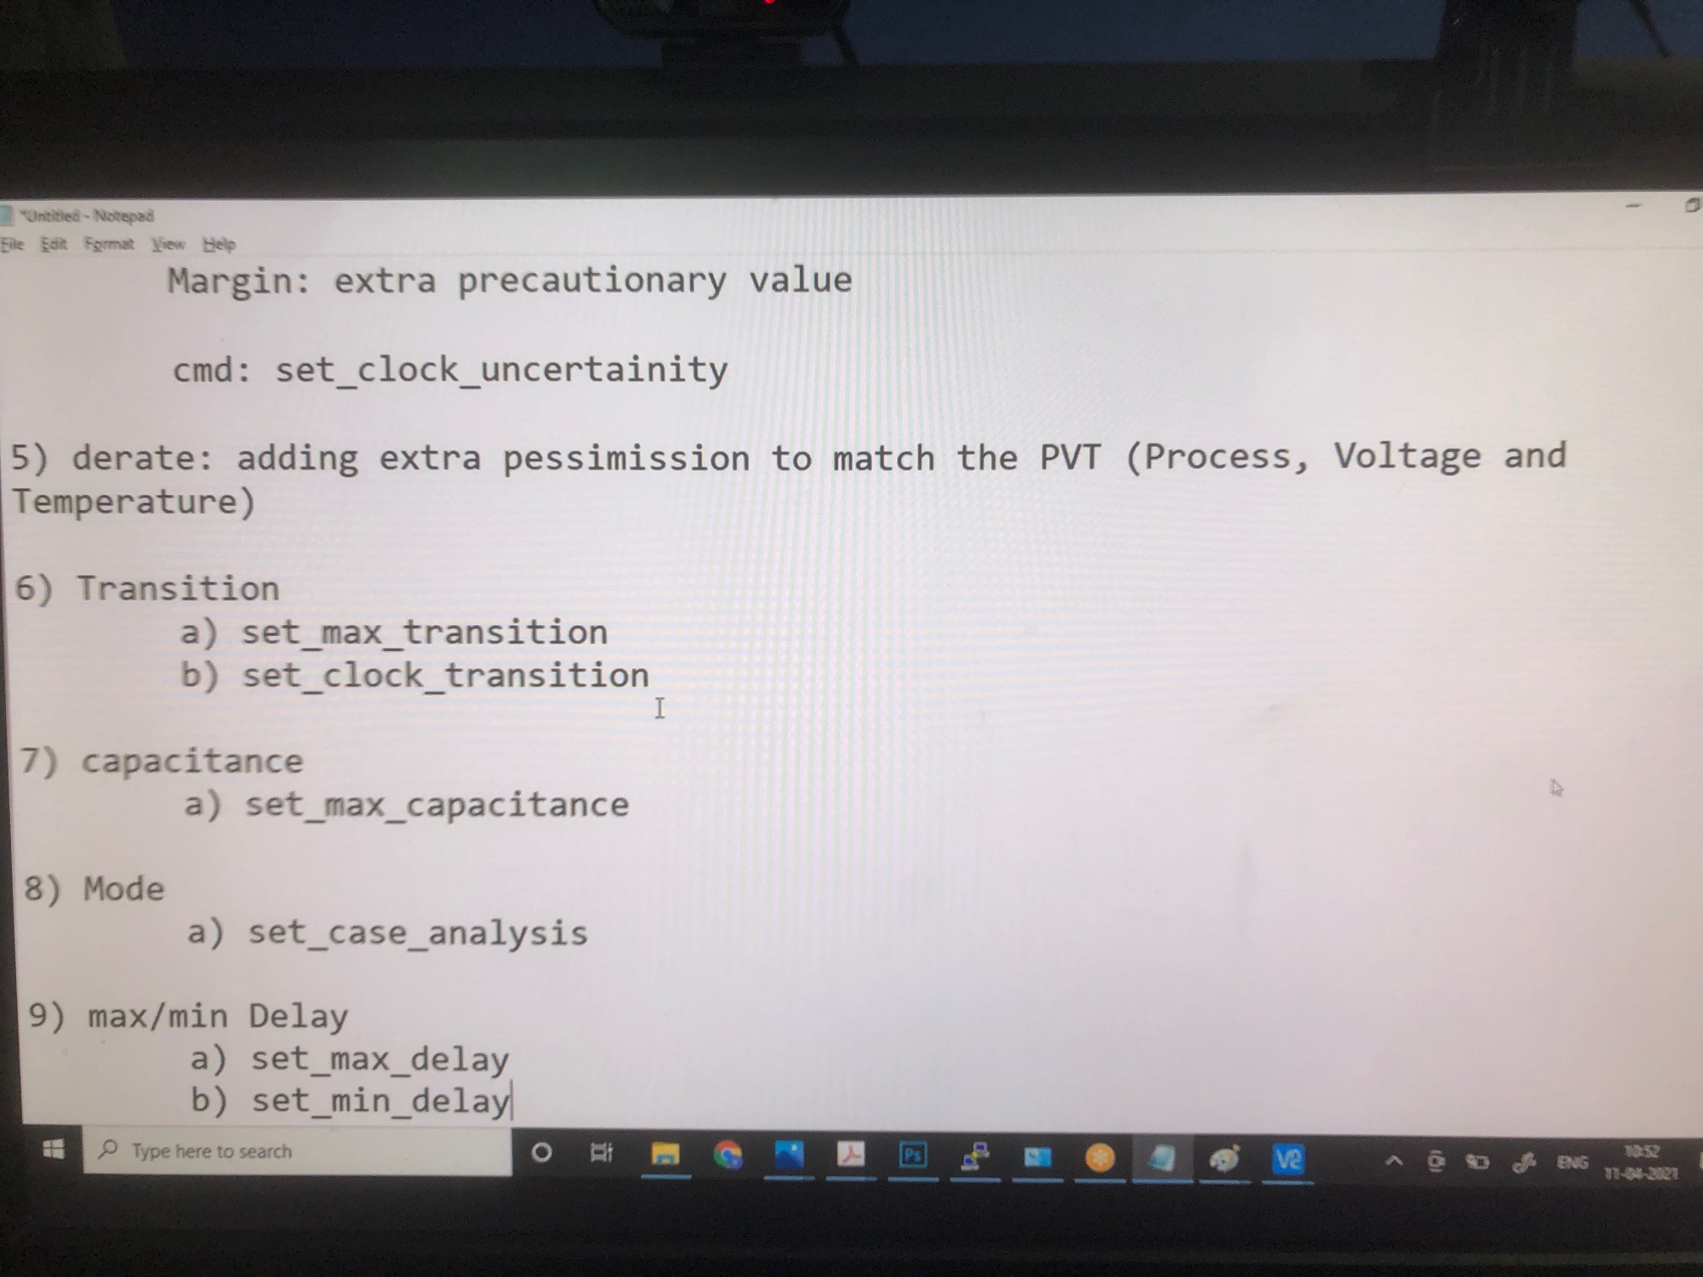

Slide 33
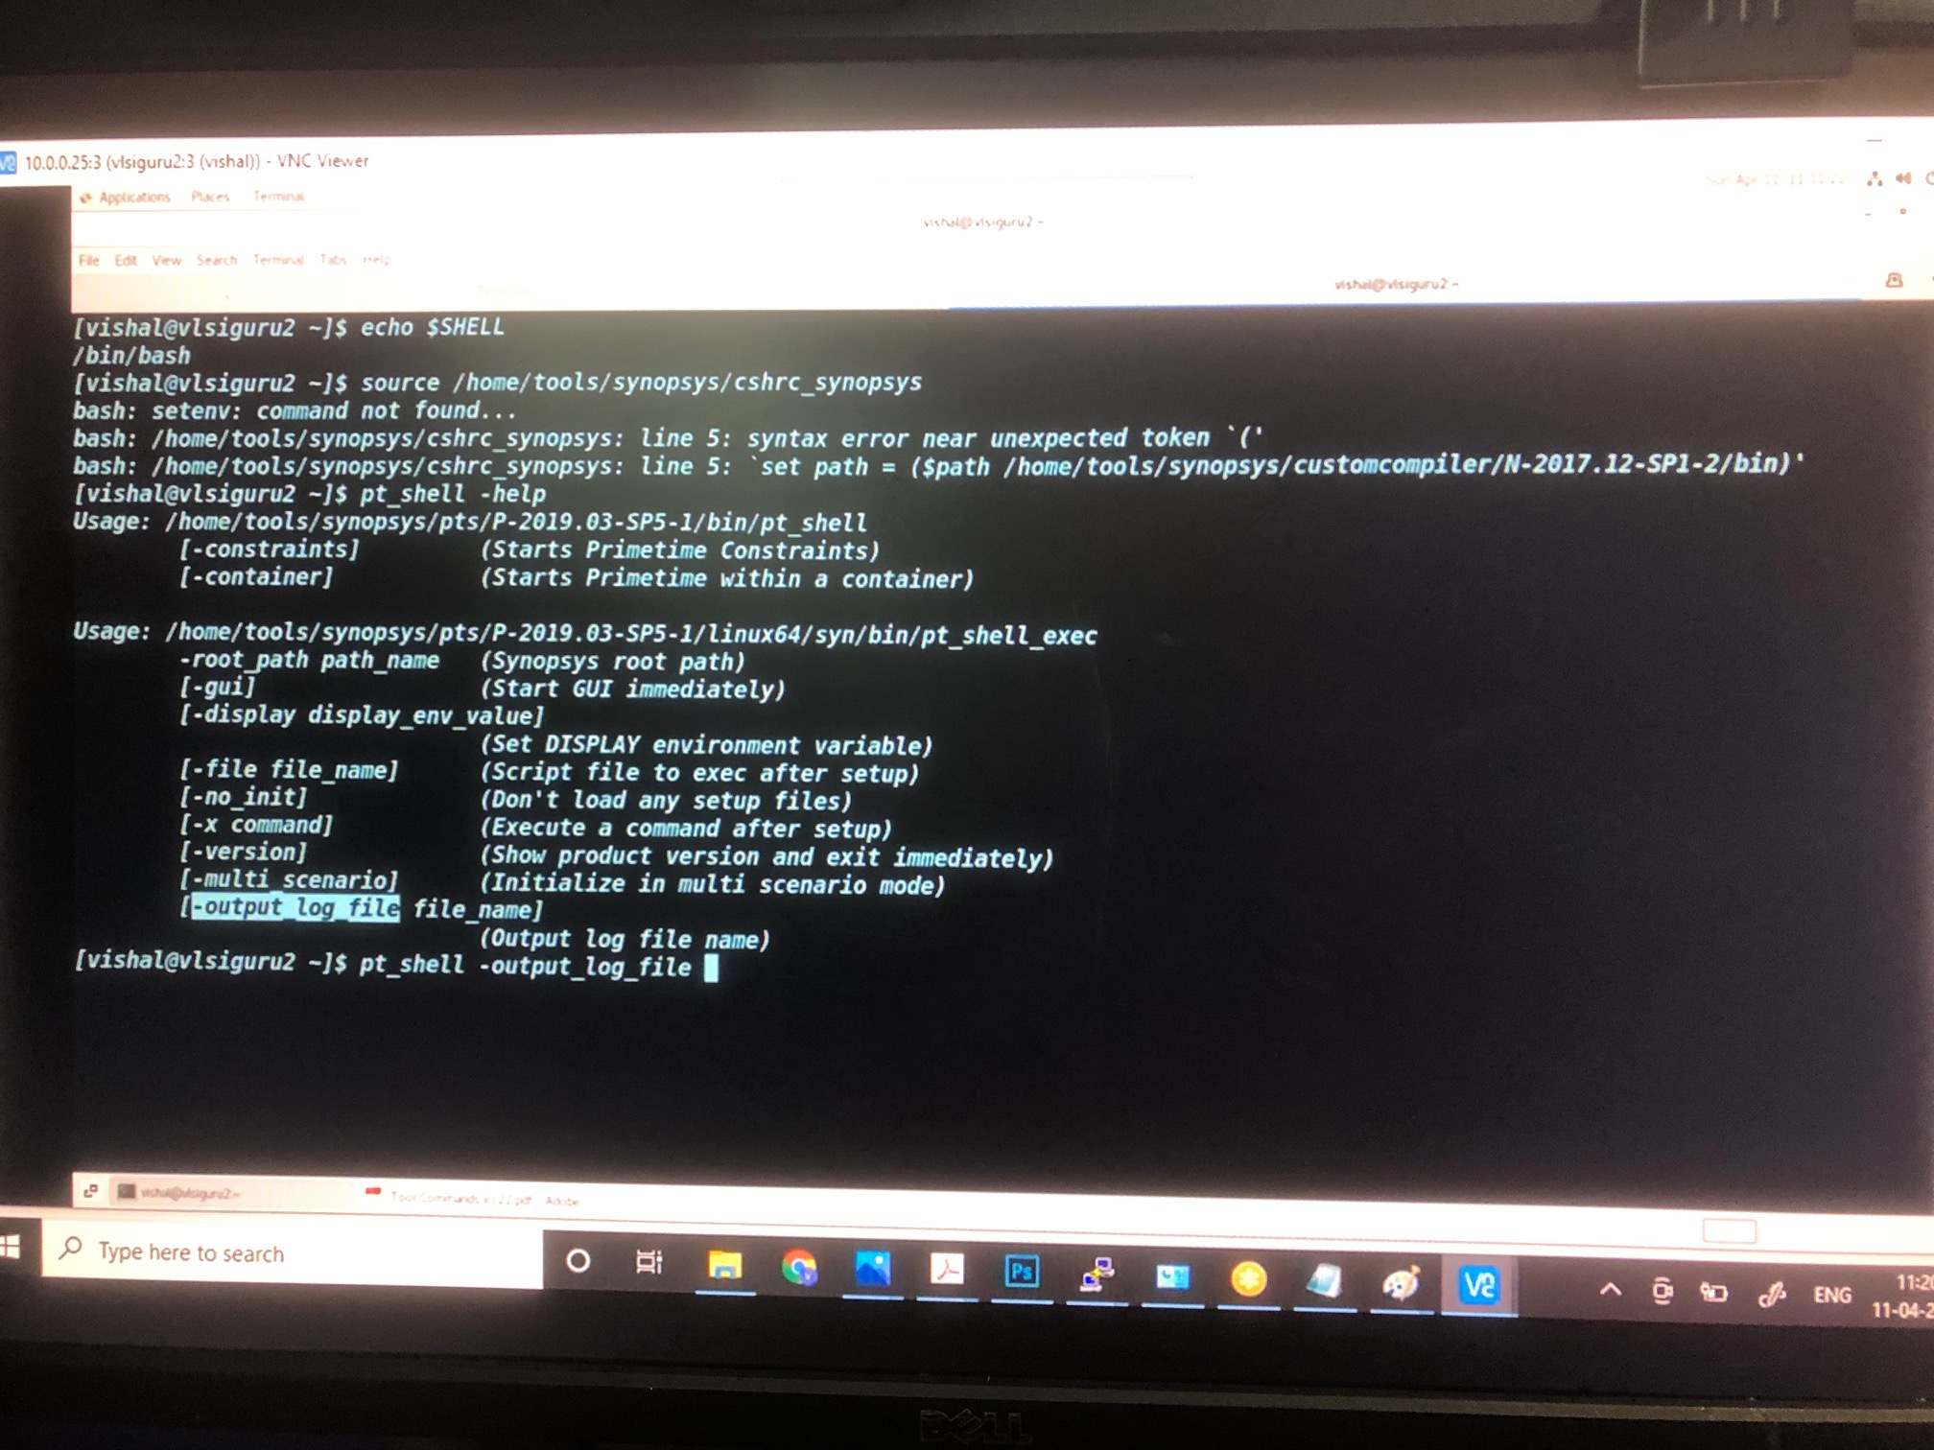

Slide 34
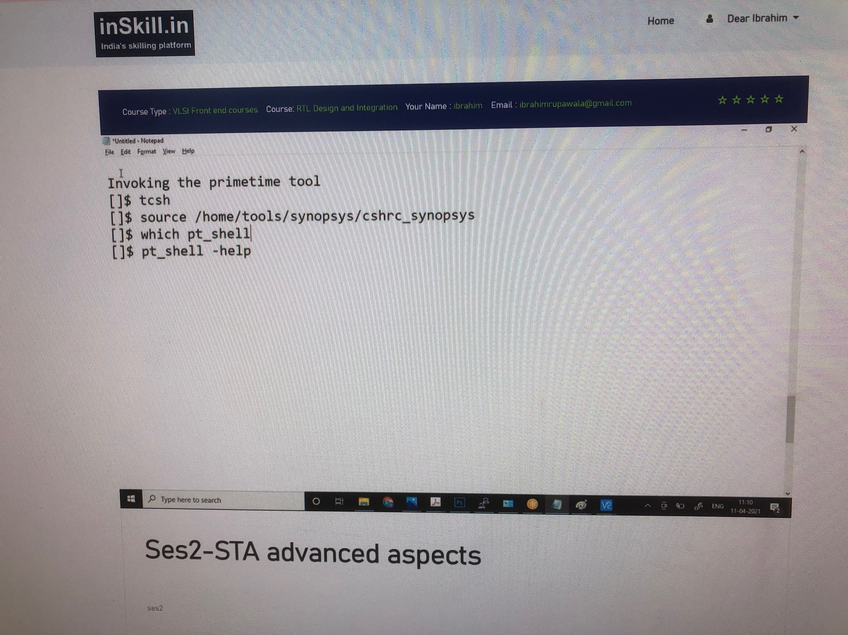

Slide 35
Lu_table_template tells w.r.t which particular factors you are able to perform that particular analysis
Cell (AND2X1_HVT) shows cell information
Timing() shows the delays based on index_1(input transition) and index_2 (load capacitance)
In the figure with Virtual Clock and Input Delay, Cell delay values will be pulled from .lib library file hence no need to provide it individually. The tool will automatically pic cell delay as well as net delay value for the CELL.
In the “Tool Commands icc33.pdf” Note that for input_delay we have to define w.r.t which particular clk input delay is defined and for which inputs
For the timing constraints notice that for the virtual clk is required for in2reg and reg2out paths while master clk is required for reg2reg paths as it is a complete path.
Also there are some reg2reg paths which will be working on a different frequency hence we will be using generated clks for them.
While defining a clock we have to also define uncertainty which is jitter (rise and fall time which depends on the charge and discharge of the capacitance of the PLL clock generator) + Skew + Margins

Slide 36
Max/min delay is for the in2out paths
Derate: adding extra pessimissm to match the PVT (process, voltage, temp) or OCV (on chip variation) of the cell
Csh is a command to move from one shell to another shell (moving from batch shell to cshell)
Tcsh (moving from batch shell to tshell)
Then source the license agreement file source /home/tools/….
To Check which particular shell you are working with currently use the command “echo $SHELL”. Notice that it is important to invoke the right shell as your source commands might not work on another shell
Before Invoking any shell try to invoke –help meaning pt_shell –help, dc_shell –help, etc
To store the logs of shell on a particular day use command pt_shell –output_log_file 11_04_2021.log

Slide 37
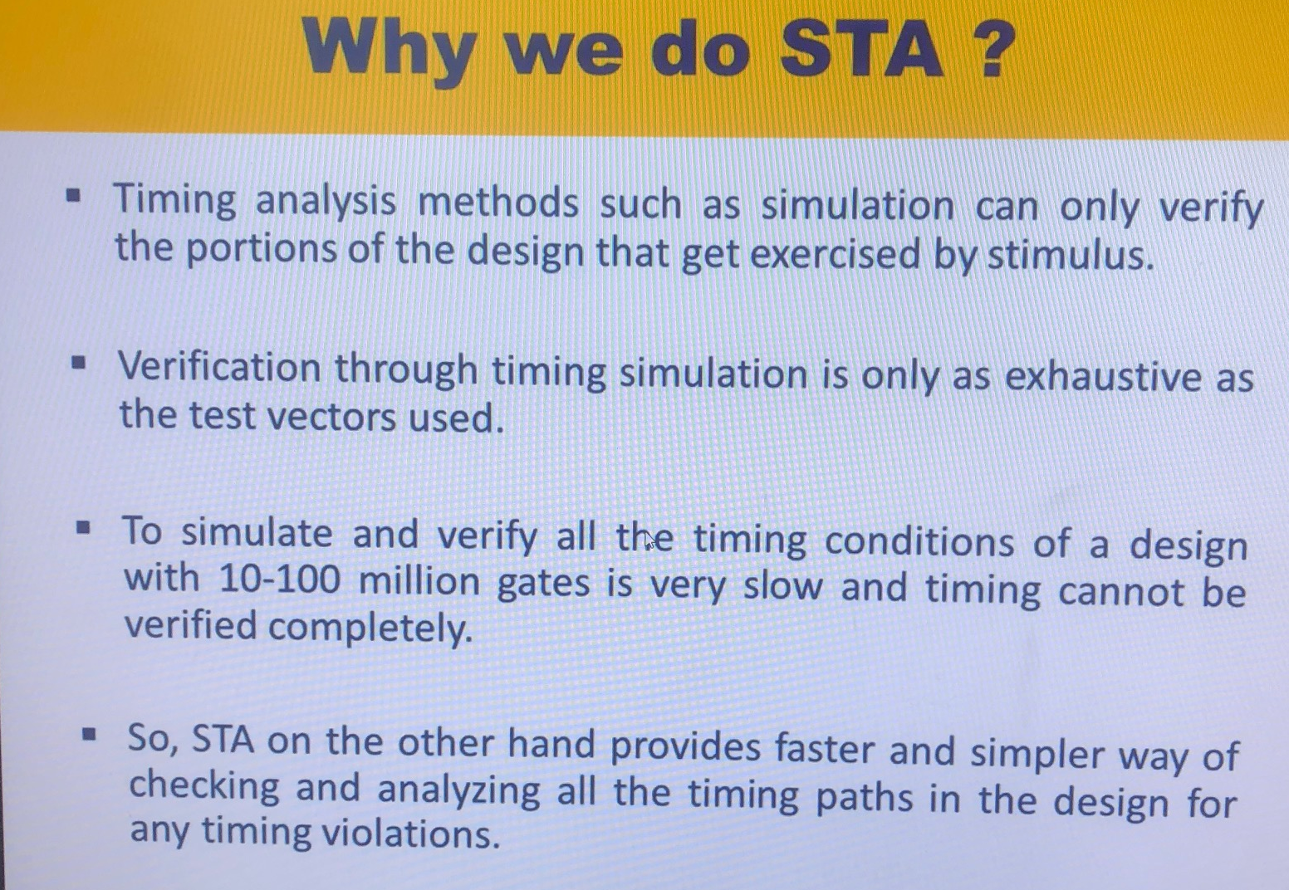
Why we do STA ?
ARCs for sequential ckt are CLK2Q and RESET2CLOCK
Combinational ckt have propagation delay
Different combinations of libraries (delays, library vendors provide these libraries) are provided for different PVT conditions (30, 40, 50 corners for HV, LV, HT, LT, etc) from the library. STA tool will pick those delays and perform timing analysis.

Slide 38
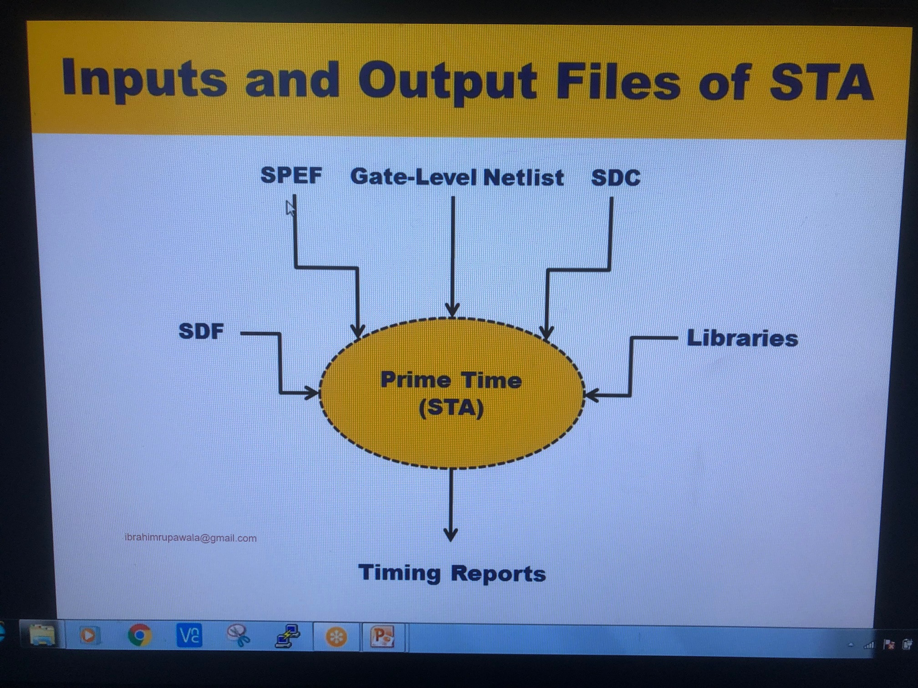
Inputs and Output Files of STA
SDF – Standard delay format - Cell and Interconnect delays of any net and cells. (Available from PnR tools). Same file can be used for STA timing tools and GLS tools.
SPEF – Standard Parasitic Exchange Format – has Resistance and Capacitance values (Available from PnR tools)
Gate-Level Netlist – This will have logic information. Available from Synthesis team
SDC – timing constraints, based on this we will be testing. It can have different clock information
Libraries – Information it has is covered in previous slides. Different tech Lib are available for different PVT corners
Output is Timing Reports
STA Signoff is performed at each level. IP level, Design Level, etc.
Final STA Signoff is performed after PnR and CTS. Netlist info is available from PnR and Clock Information is available from CTS. Hence STA is iteration based process. After generating netlist, SPEF and other stages STA is performed.
Extracted cell information is used which will have R&C values based on which timing delay will vary.
Libraries will receive R&C values, from SPEF files based, CLK2Q delay, propagation delay, input2out delay, setup and hold time delays are available from SDF files based on which it will “Look Up” for delays and generate reports

Slide 39
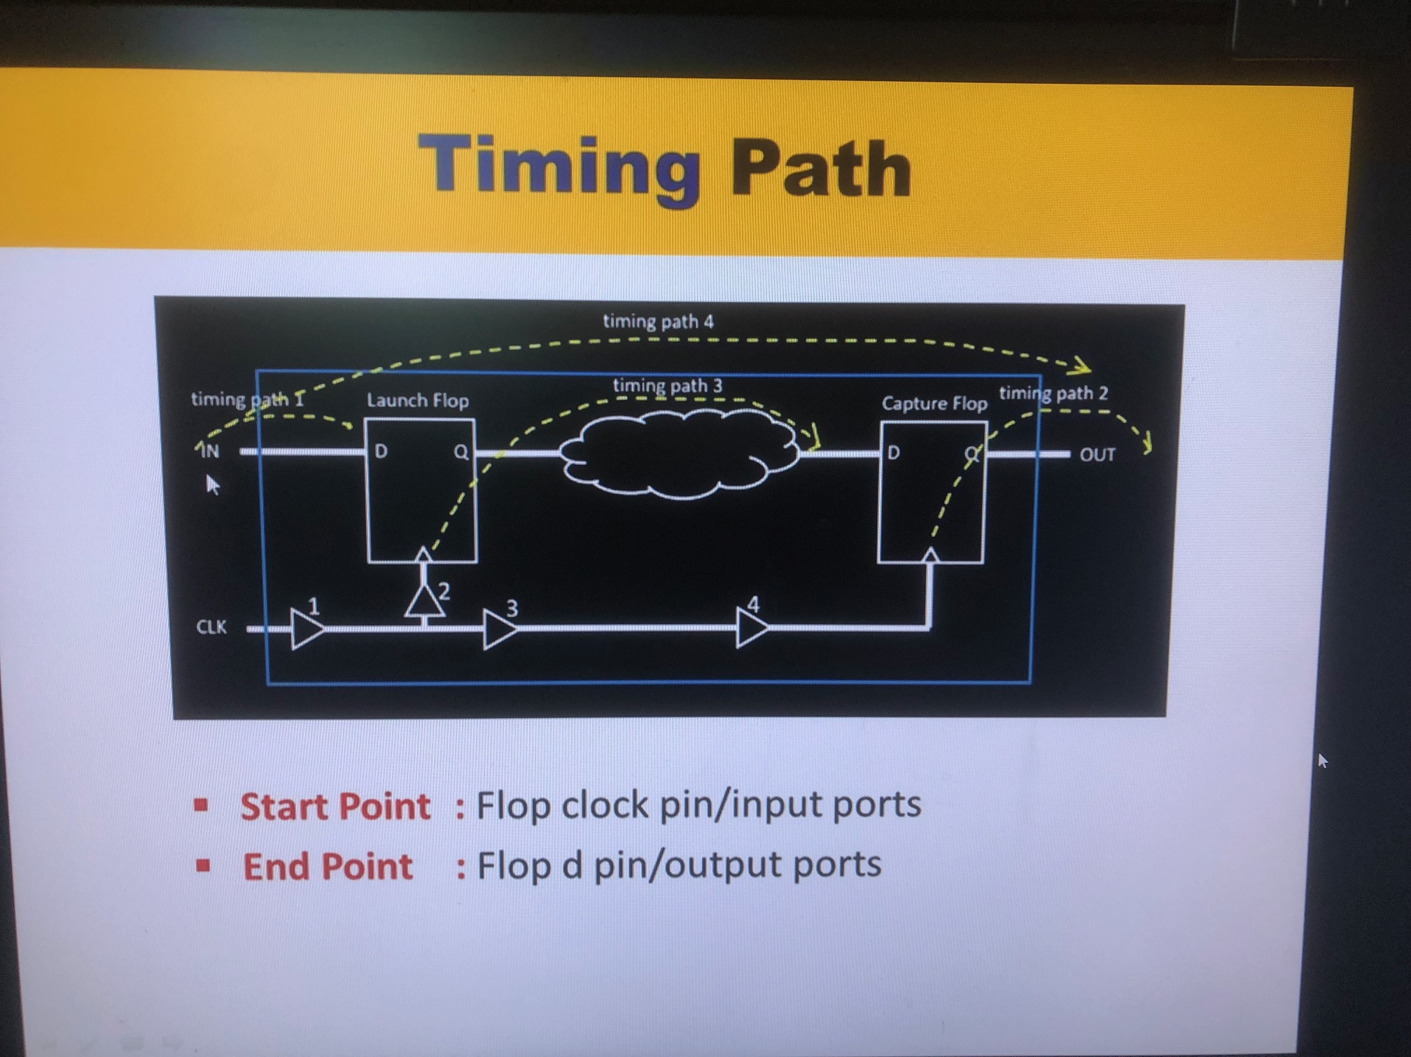

Slide 40
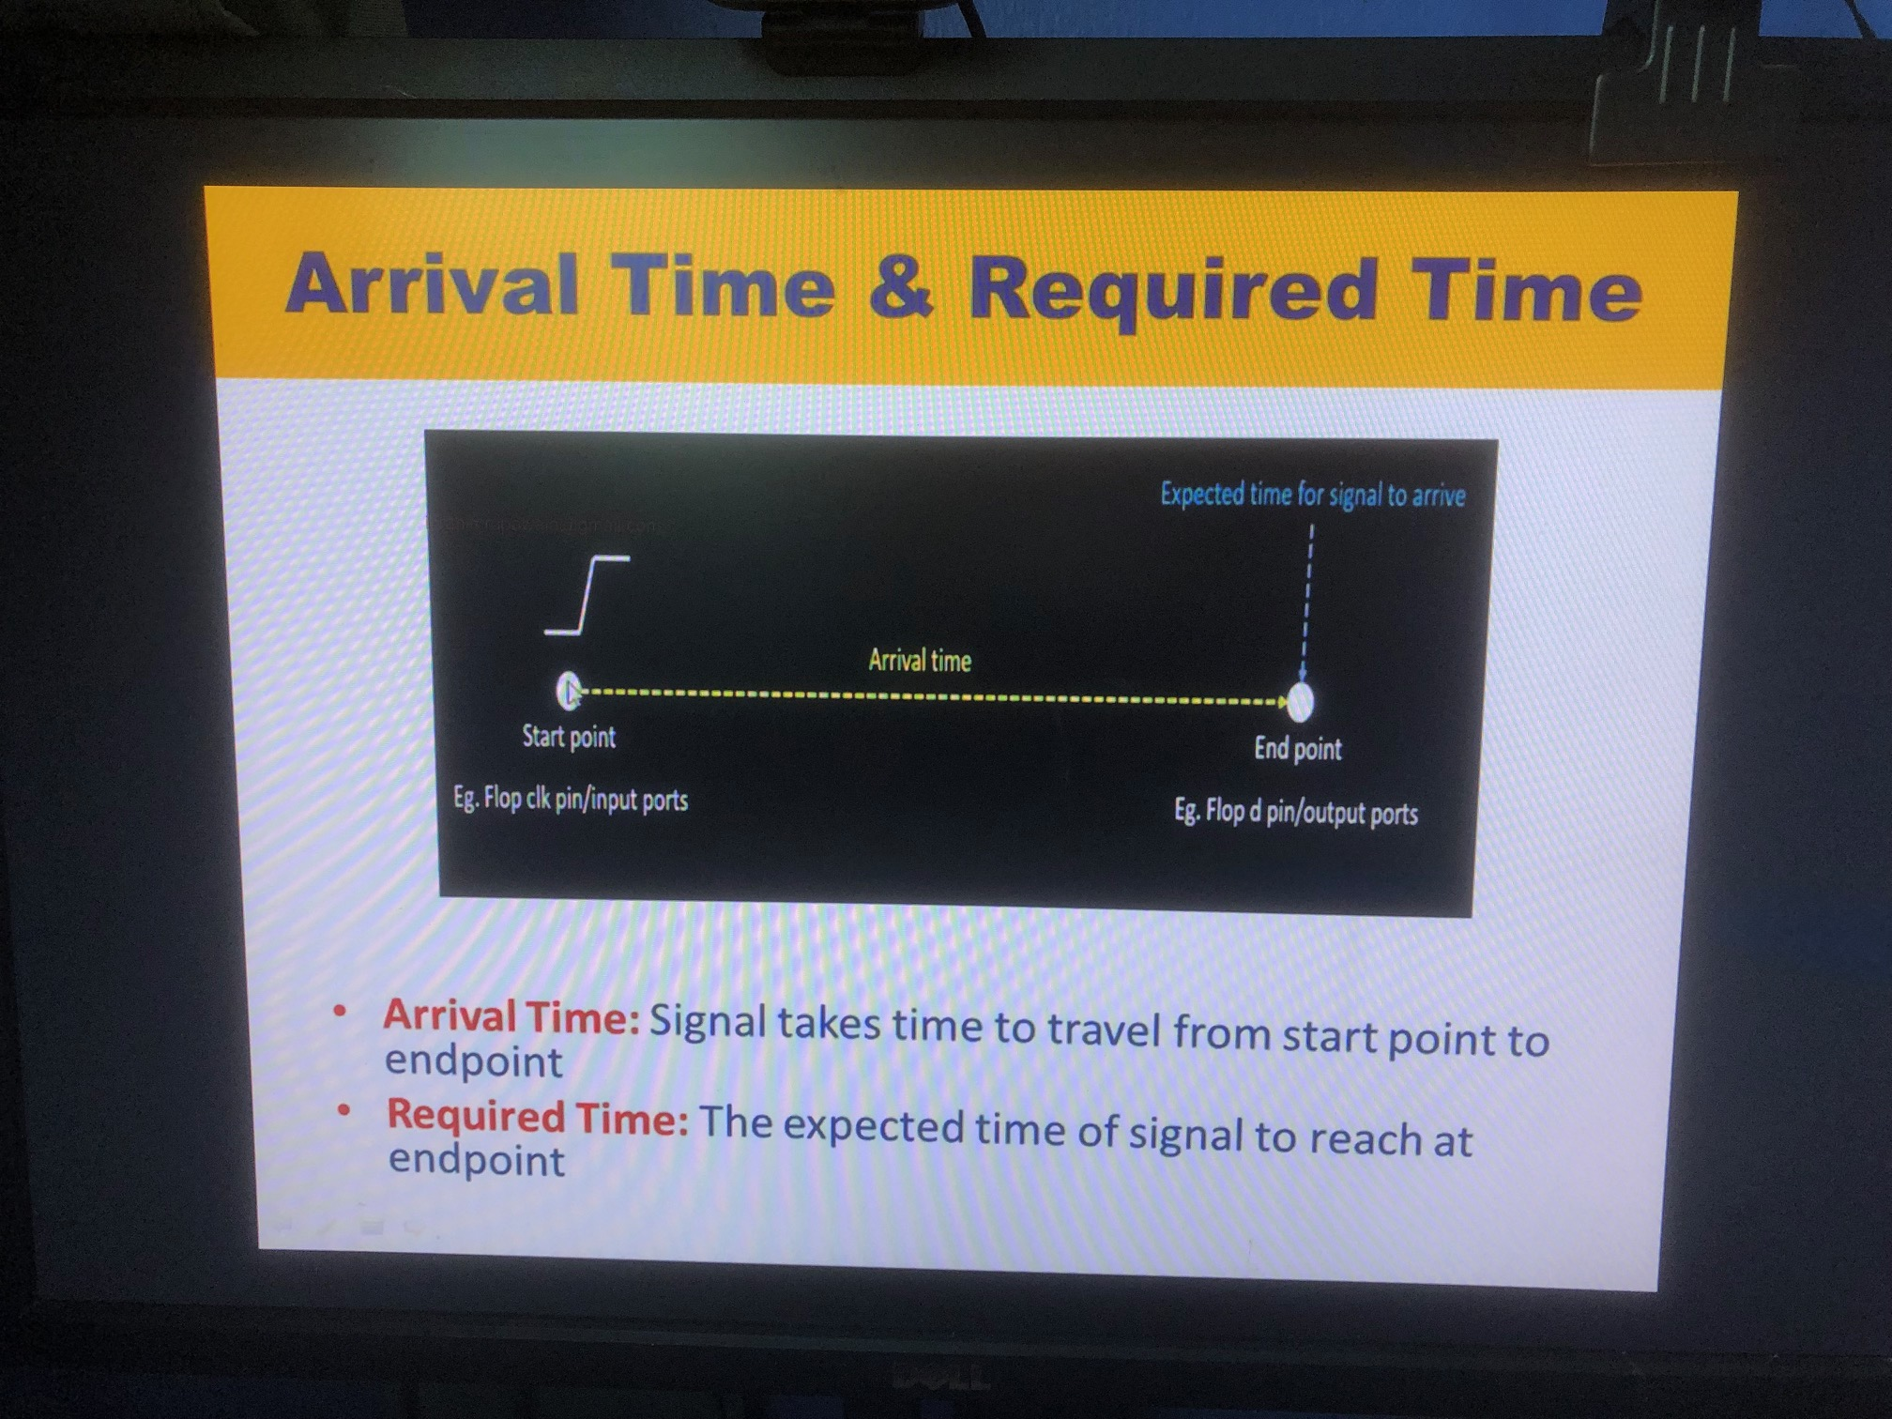

Slide 41
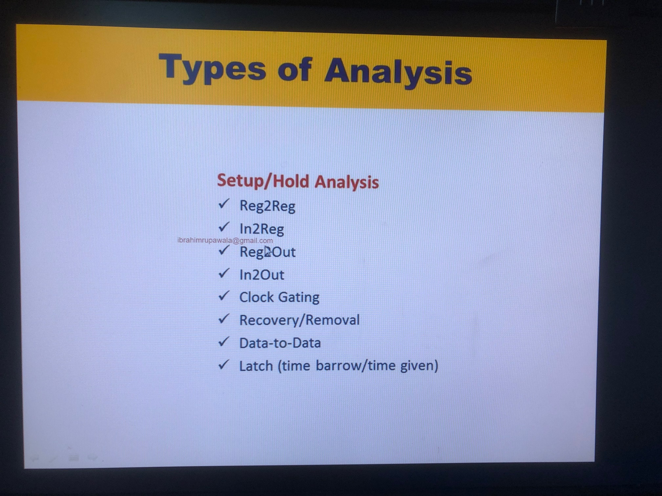

Slide 42
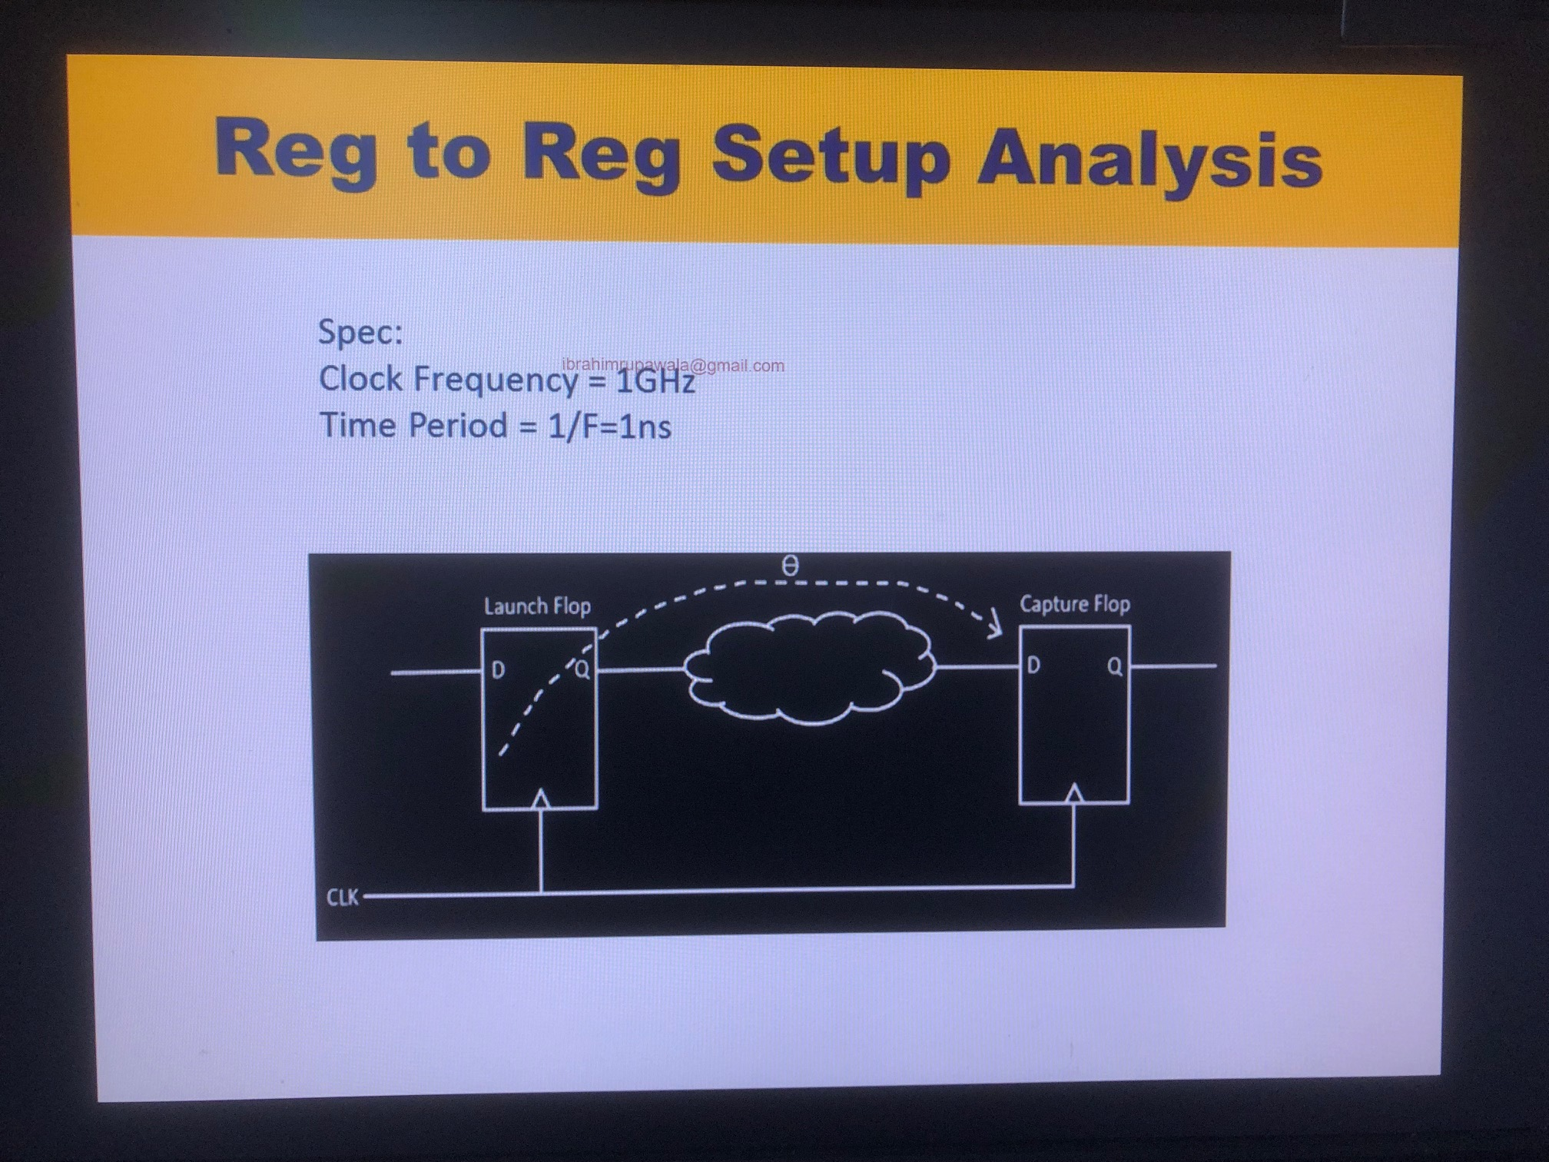

Slide 43
Slack
Slack
Setup Slack = Required Time – Arrival Time = Delay for Min Clock Path – Delay for Max Data Path
Hold Slack = Arrival Time – Required Time = Delay for Min Data Path – Delay for Max Clock Path
Slack should always be positive

Slide 44
ECO Information
Recovery/Removal means w.r.t reset signal. CLK2RESET Arc is called recovery and removal.
CLK2Dpin Analysis is setup and hold for Reg2Reg, In2Reg, Reg2Outm In2Out. Arc is D2CLK.
If the timings are violated then after one point RTL is freezed hence it is required to bring change on GLN by generating an ECO and then do LEC.
For ECO lets say some connections is wrong that is say instead of AND gate we used OR gate hence, the OR Gate will be there in the chip but it will not be connected to anything. Inputs and Outputs will be tied. Spare cells are available in the netlist and also during PnR, these unwanted cells will be inserted in spare cells. This is ECO, where we can remove some logic, disconnect some logic, reconnect some logic, etc. After change in the netlist we have to perform LEC between RTL to Netlist.
We will also correct RTL but we will not provide this RTL to PD team. We will again perform LEC between corrected RTL and modified ECOed Netlist.
Spare cells are given by PD team to add some logic. RTL2NETLIST changes are done with ECO. Logic should be same between GLS and RTL. This is checked with LEC.
Noticed that there are many kinds of ECO’s: Functional ECO, Timing ECO, Power ECO, Metal ECO, Layout ECO.

Slide 45
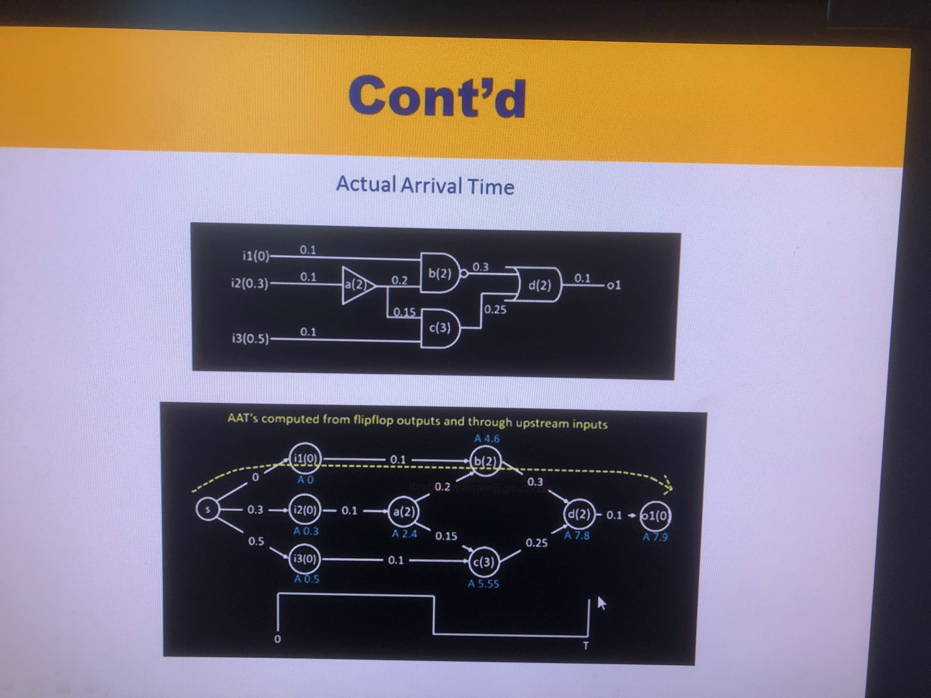
Required Arrival Time Slide
Note that Actual arrival time is the time delay in the forward path Q of Reg1 to D of Reg2
Required arrival time is the time delay in the reverse path D of Reg2 to Q of Reg1. Starting value is time period which is 7.55 here for the last node.
Slack is calculated for each node. Note that for few nodes some slack is meeting and few are not. Report throws the worst case slack critical path.
For the critical violating paths we have to fix it by breaking the path, upsizing the cells in the path,
Based on the report we have to optimize or constraint our design tightly so that it will optimize the design tightly. Optimize meaning it will chose higher drive strength cells which will have less delay.

Slide 46
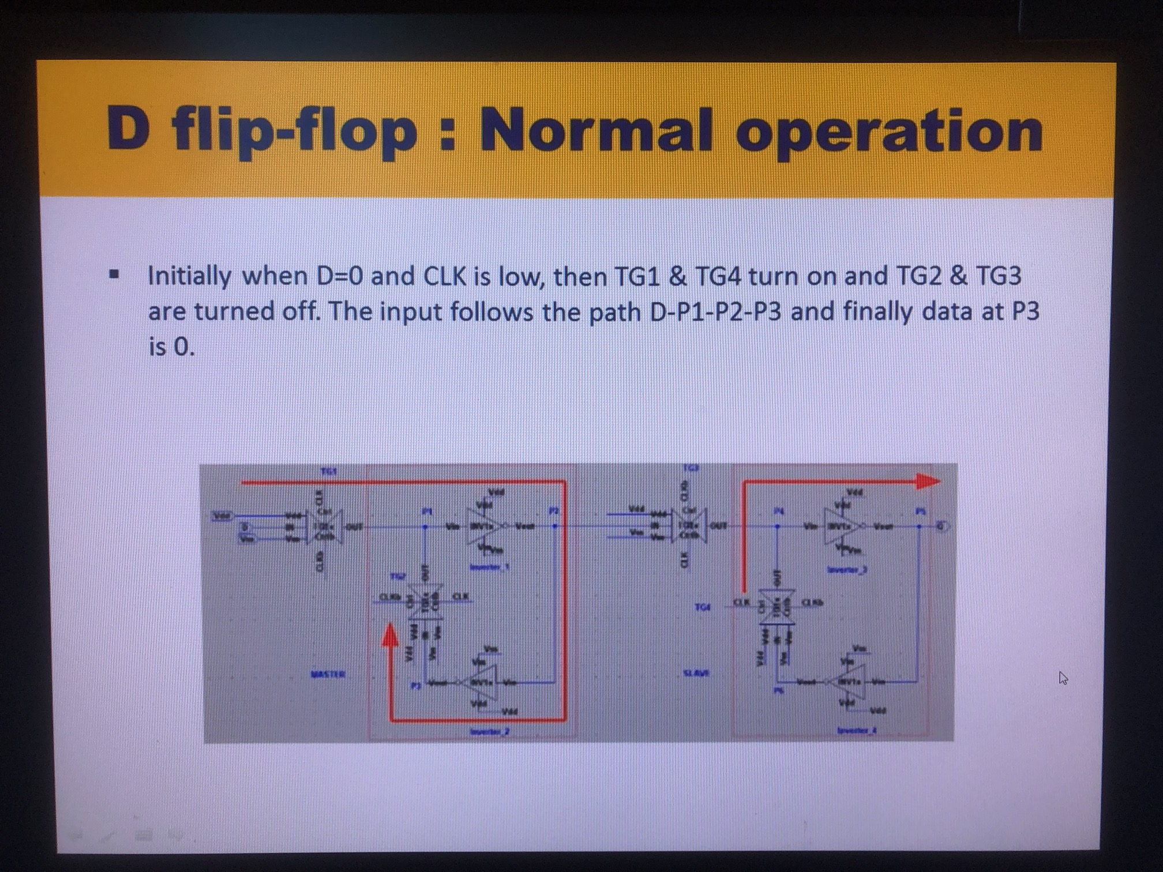

Slide 47
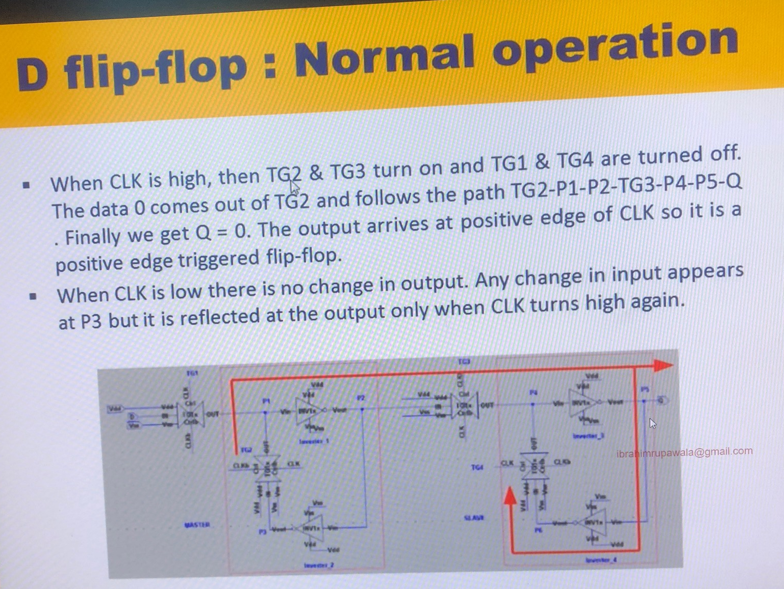

Slide 48
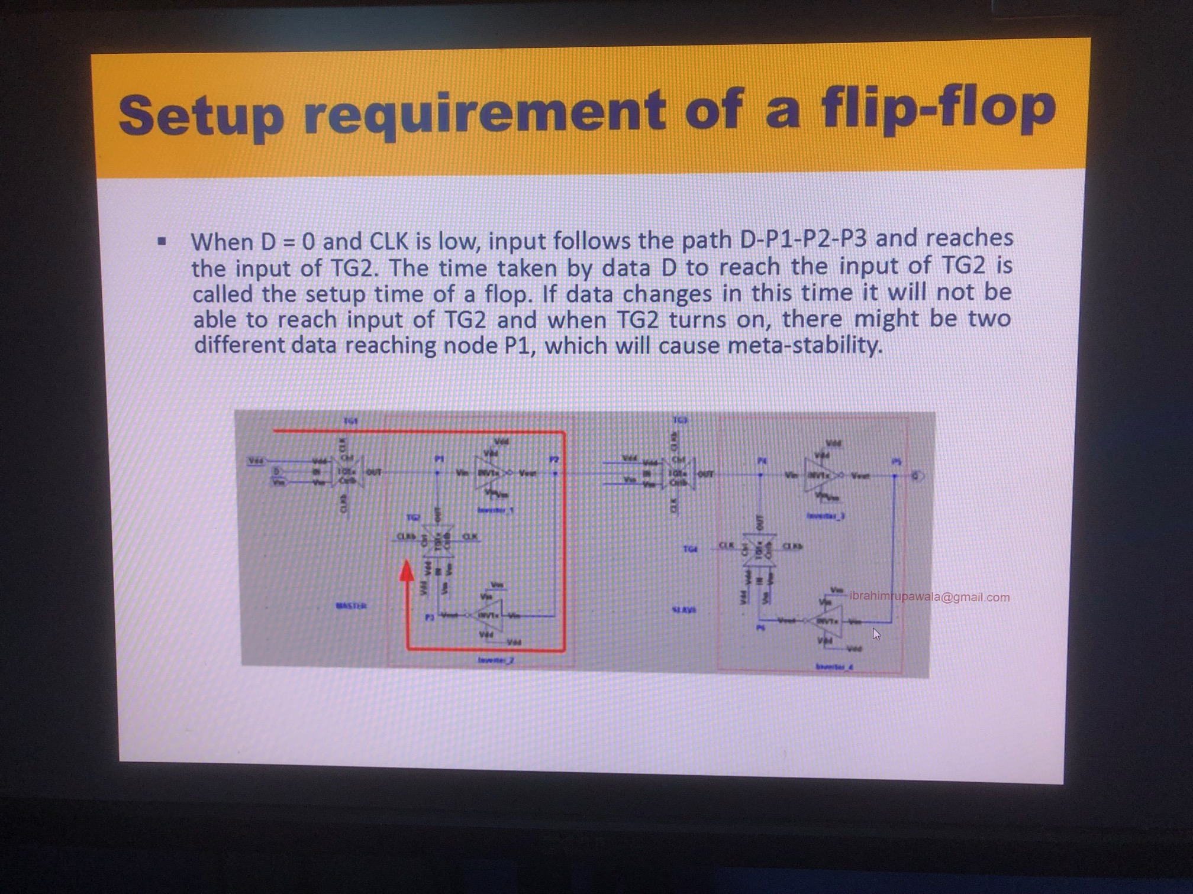

Slide 49
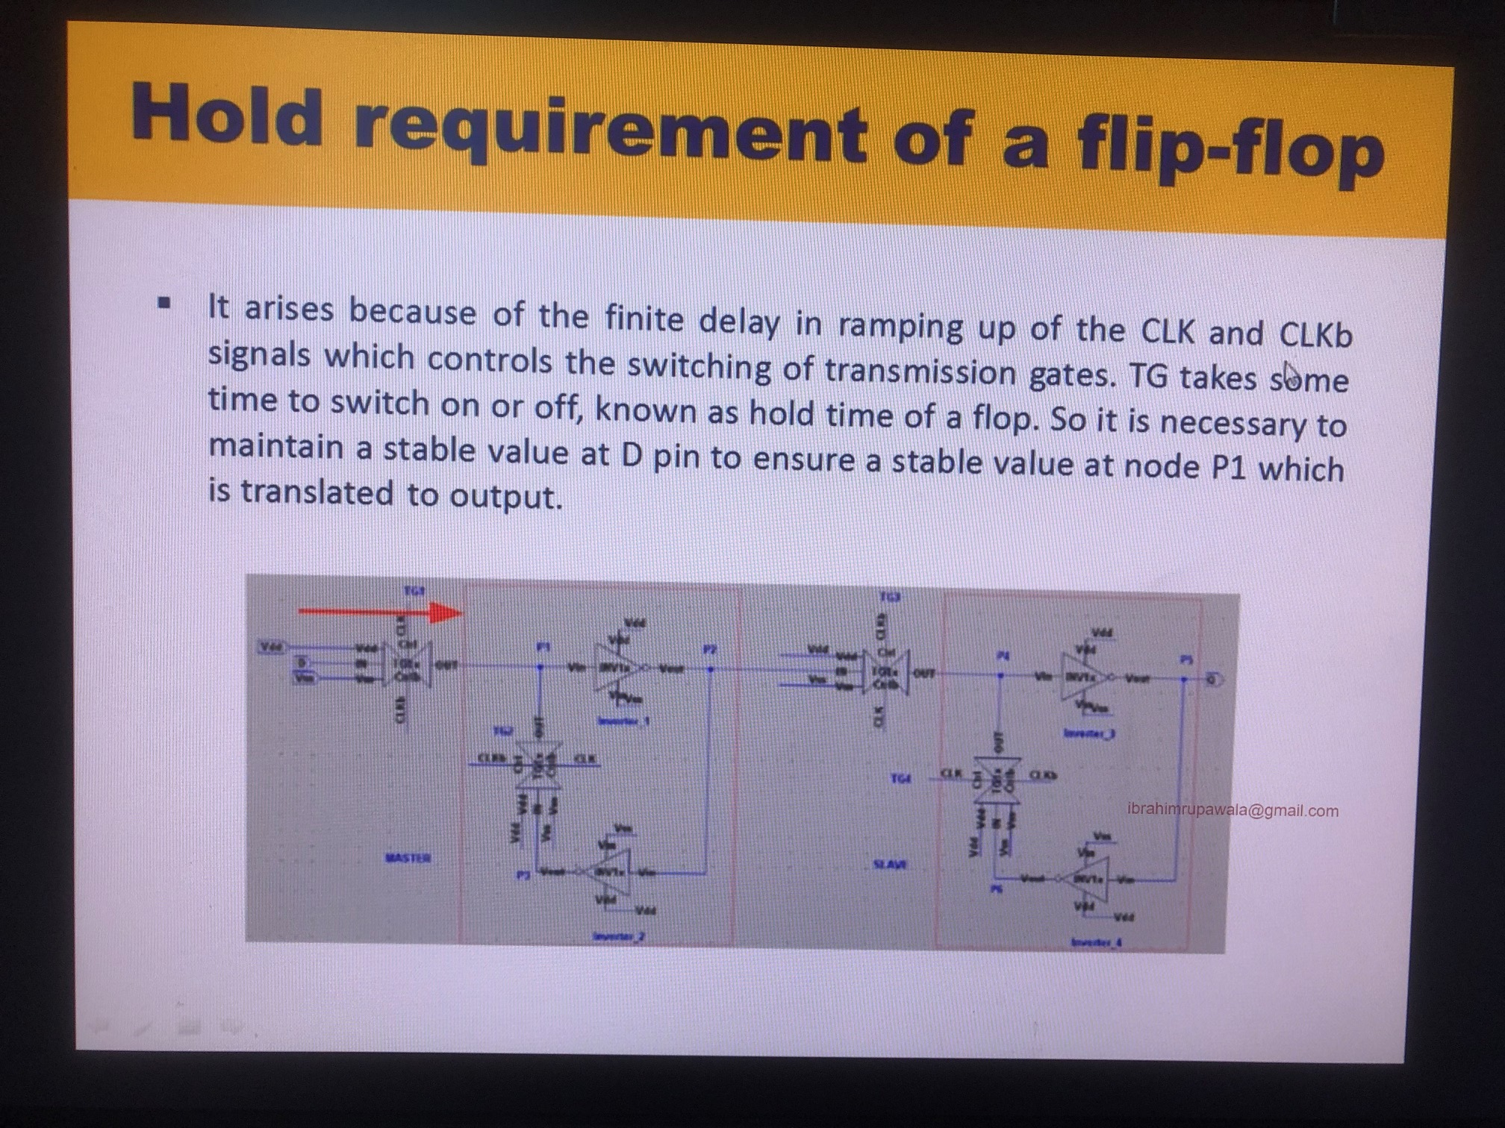

Slide 50
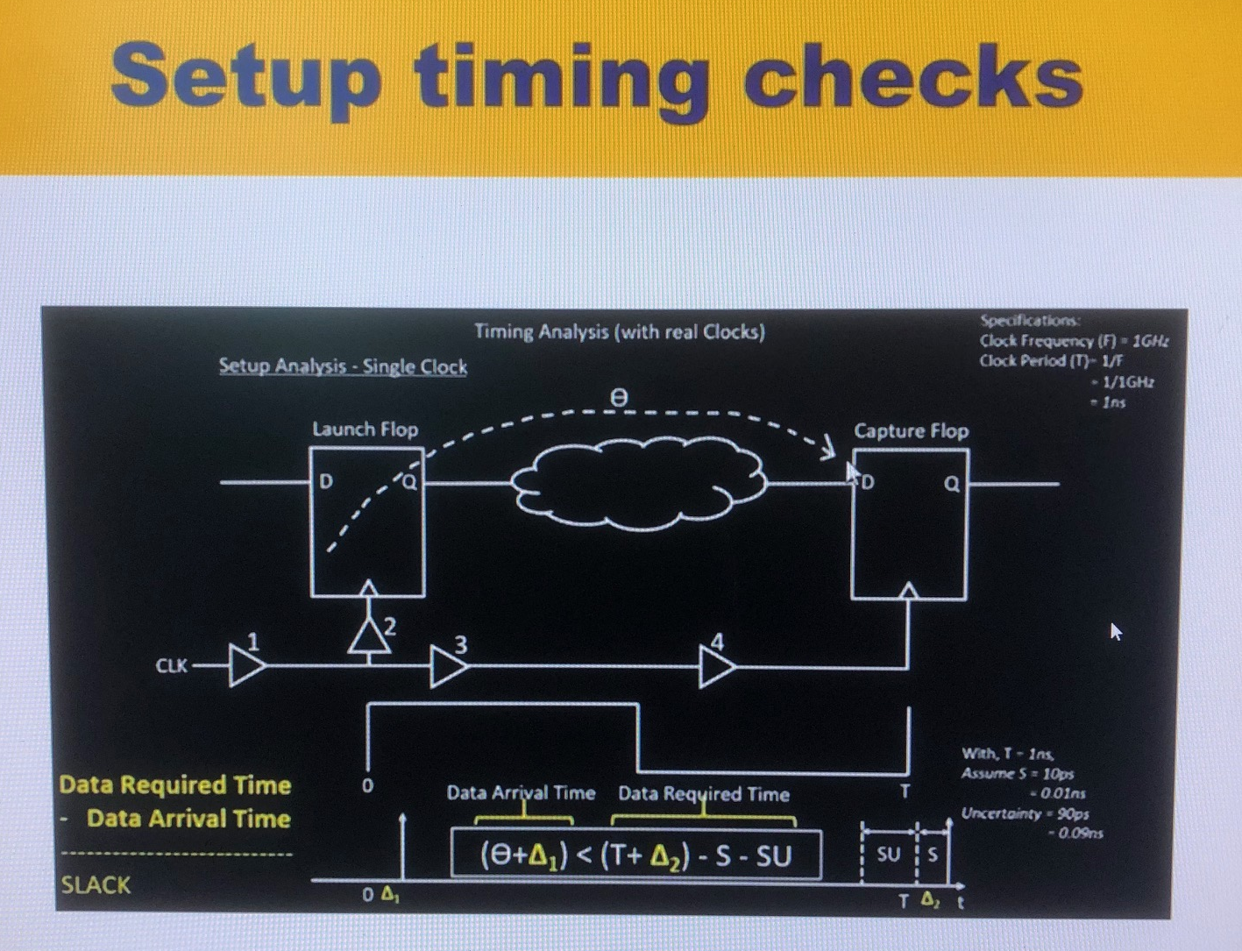
Timing Analysis
S = Setup of Flip-Flop
SU = Setup Uncertainty of the clock ??
Setup Uncertainty is required because after CTS, actual buffers are included in timing paths. If uncertainity margins is not considered while performing analysis for pre-layout netlist then we will see a drastic change for pre-layout and post-layout timings because of buffers included in the timing paths during CTS.
Setup Uncertainty will be sub while performing setup analysis
Hold uncertainty will be added while performing hold analysis

Slide 51
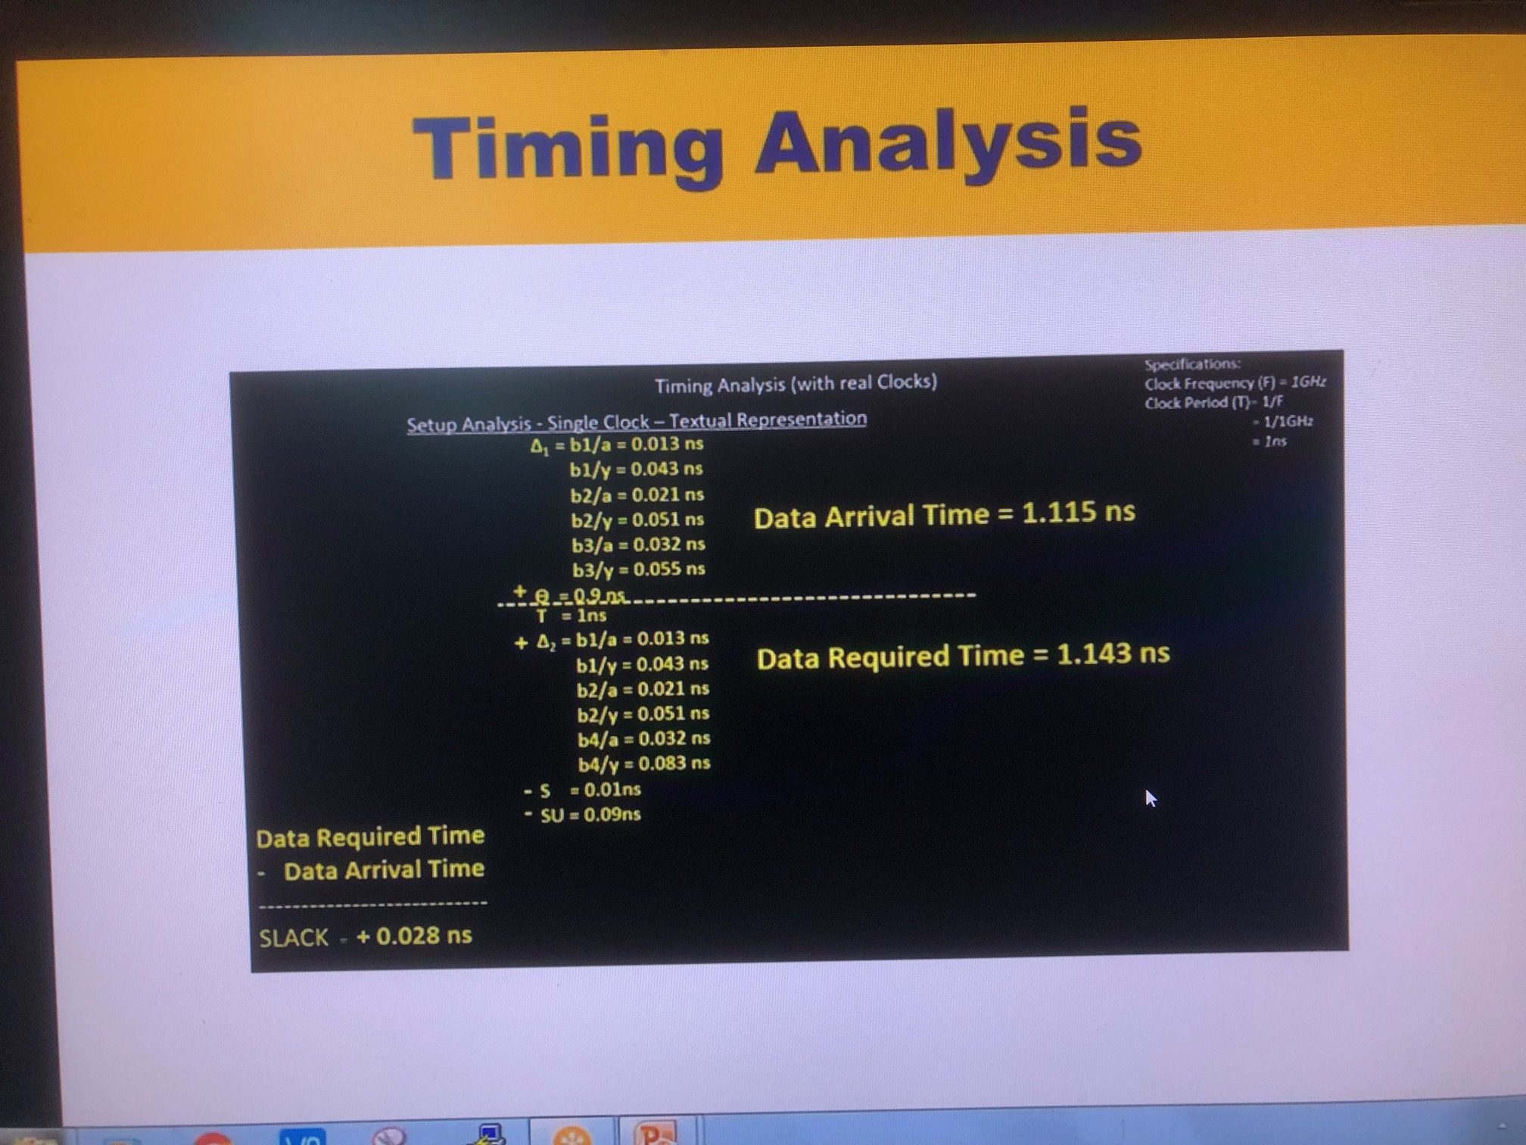

Slide 52
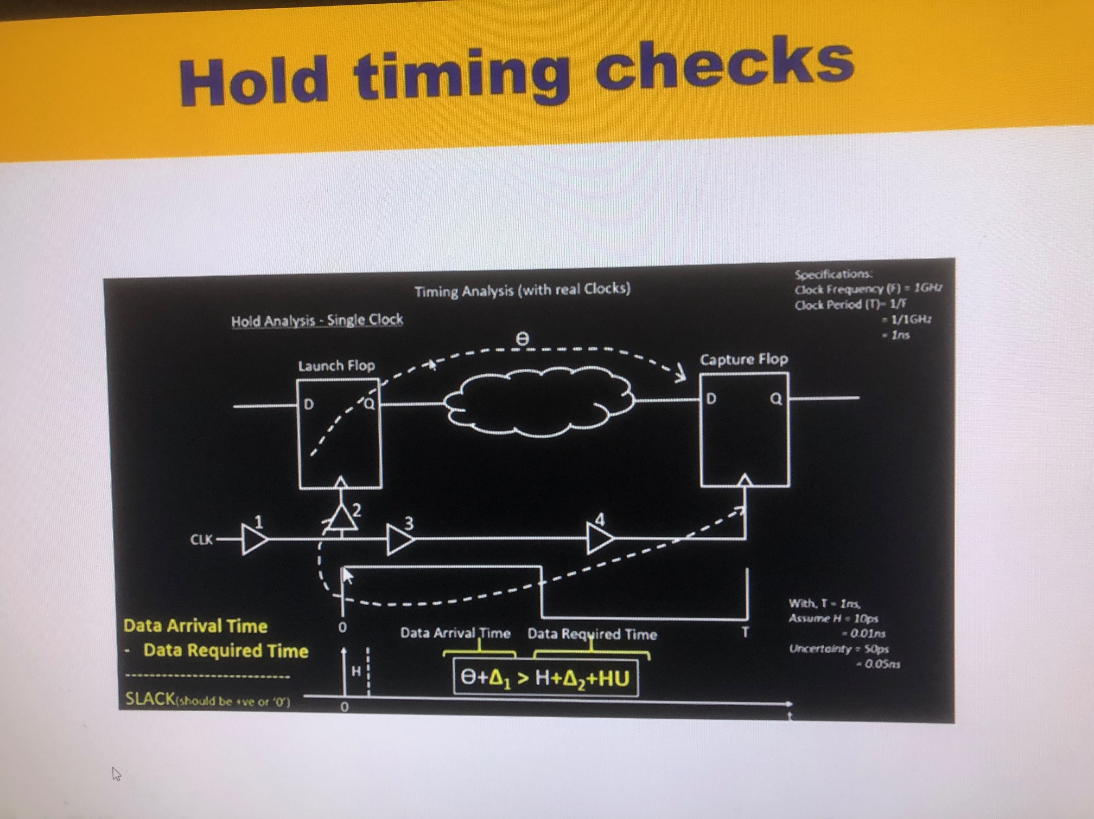

Slide 53
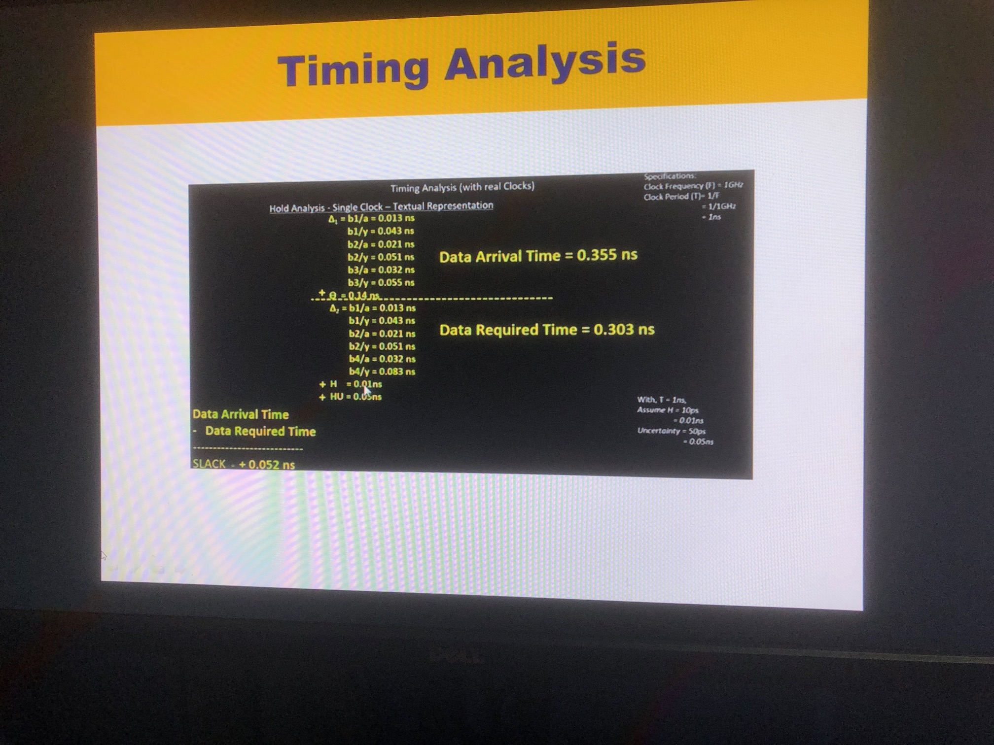

Slide 54
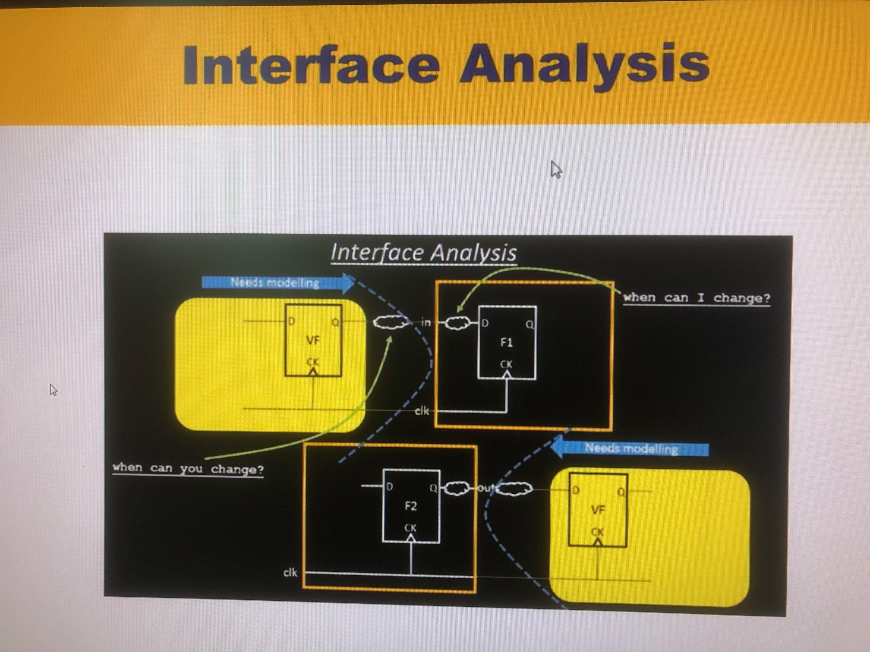
Interface Analysis
In the previous figure we have analyzed timing constraints of reg2reg paths but we have to also perform timing for in2reg, reg2out and in2out paths. Concept remains the same for these paths but in and out changes.
In this figure notice that in2reg and reg2out are the yellow external timing ARC’s.
We have to define virtual clocks for these external timing ARC’s as well as provide set_input_delay and set_output_delay for the little combinational logic between output of the flop before the input of our design and input of our design and output of our design and input of the flop after it respectively while performing timing analysis. Observe that set_input_delay and set_output_delay are for “needs modelling” in the figure.

Slide 55
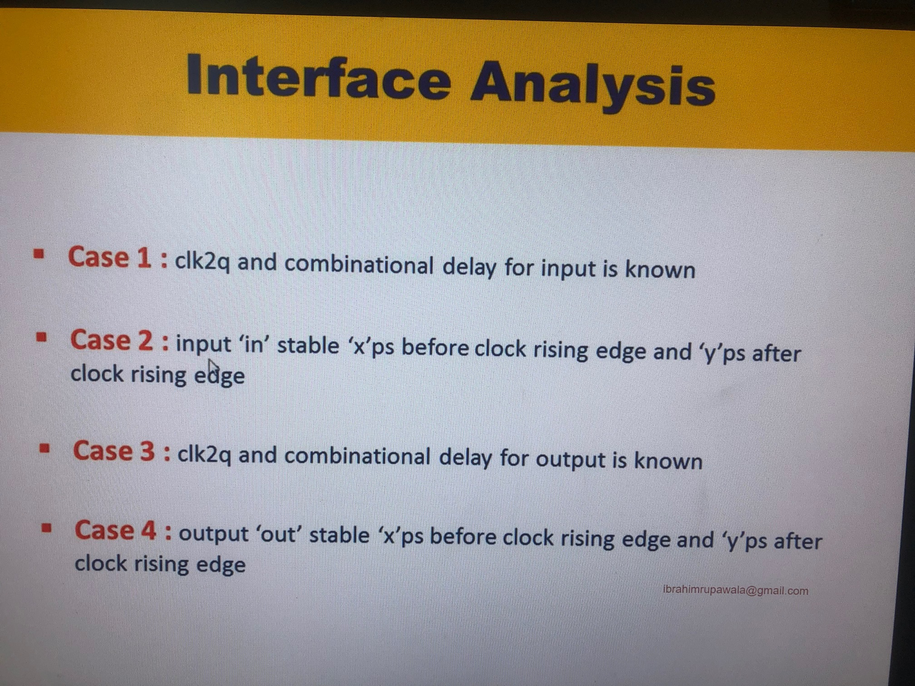

Slide 56
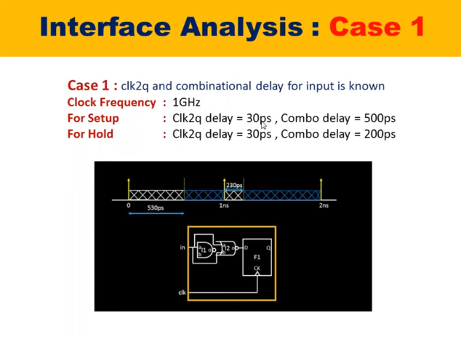
Interface Analysis: Case 1
Signal should be available by 530ps on the input pin in for it to be properly captured by our design
Blue line indicates where data cannot change.
Assume that next edge at 1ns where hold time is to be calculated is also at 0ns.
Notice that data window is between 230ps to 530ps. In between that time only data will be changed. I cannot change before 230ps(hold) also it cannot change after 530ps(setup)
Hence set_input_delay –max = 530ps (for setup analysis)
Set_input_delay –min = 230ps (for hold analysis)

Slide 57

Interface Analysis: Case 2
Hence set_input_delay –max = 530ps → (1000 – 470)ps (for setup analysis)
Set_input_delay –min = 230ps (for hold analysis)

Slide 58

Interface Analysis: Case 3

Slide 59

Interface Analysis: Case 4

Slide 60

Clock Gating Analysis
To reduce the Dynamic Switching Power
In this circuit when EN is off Mux will keep on rotating data from CLK->D->Q which will waste lot of power. latch based clock gating is inserted when such kind of circuits are present.
Instead of this MUX Architecture we will insert a latch.
Hence now we have to analyze register to latch timings for ICG Cells.
ICG cells can also be inserted in the synthesis by DC shell.

Slide 61


Slide 62


Clock Gating Analysis
To reduce the Dynamic Switching Power
https://www.youtube.com/watch?v=de5iH6CHr8E
https://www.youtube.com/watch?v=LK12R_PbBts

Slide 63

Integrated Clock Gating
Notice that in Integrated Clock Gating circuit the latch used is negative level triggered which will not allow any data to toggle when clock is high thus eliminating all the clock glitches.
Verilog code for Integrated Clock Gating
Input en, clk;
Wire en_latch;
Output clk_gated;
Always @ (*) begin
if (~clk) en_latch = en;
Clk_gated = en_latch & clk
end
Refer this link - https://stackoverflow.com/questions/24977925/how-to-use-clock-gating-in-rtl

Slide 64

Asynchronous Resets..
Notice that Synchronous Reset shown with AND gate and MUX is a problem for high freq circuits because it will add more delay to the datapath and hence time period will increase
Also, lets say clock gets gated, then the reset will never be applied as it is synchronous to clock edge !!. It needs clock for both assertion and de-assertion

Slide 65

Asynchronous checks
Assertion of reset happens asynchronously but De-assertion happens synchronous to clock.
De-assertion creates meta-stability here as it is synchronous. Solution – RESET SYNCHRONIZERS.
Clock to Reset – Recovery (setup) and Removal (hold) checks
Clock to Data – Setup and Hold checks

Slide 66


Slide 67

Reset Synchronizer Ckt is shown (Though title is Asynchronous Checks)
Note that buffers are added between reset sync and reset of FF to take care of recovery and removal timings.
For the FF of Reset Sync there will be setup and hold checks

Slide 68
Reset Synchronizer
http://www.vlsijunction.com/2015/10/recovery-and-removal-these-are-timing.html#:~:text=These%20are%20timing%20checks%20for,the%20next%20active%20clock%20edge.
https://vlsiuniverse.blogspot.com/2016/09/reset-synchronizer.html
https://vlsiuniverse.blogspot.com/2020/04/timing-requirementsconstraints-related.html
https://www.youtube.com/watch?v=vmy5E1fmQIQ
http://www.sunburst-design.com/papers/CummingsSNUG2003Boston_Resets.pdf
Need for reset synchronizer: The way most of the designs have been modelled needs asynchronous reset assertion and synchronous de-assertion. The requirement of most of the designs these days is:
When reset is asserted, it propagates to all designs; brings them to reset state whether or not clock is toggling; i.e. assertion should be asynchronous
When reset is deasserted, wait for a clock edge, and then, move the system to next state as per the FSM (Finite State Machine); i.e. deassertion should be synchronous
The top level reset sources are mostly asynchronous, both in assertion and during deassertion. The circuit that manipulates the asynchronous reset to have asynchronous assertion and synchronous deassertion is referred as reset synchronizer.

Slide 69
Reset Synchronizer
Definition of reset synchronizer: A reset synchronizer synchronizes the deassertion of reset with respect to the clock domain. In other words, a reset synchronizer manipulates the asynchronous reset to have synchronous deassertion.
Verilog Code
// Reset Synchronizers
// Assertion happens ASynchronously and De-Assertion happens Synchronously.
module reset_sync(asyncrst_n, clk, rst_n);
input asyncrst_n, clk;
output reg rst_n;
reg rff1;
always @(posedge clk or negedge asyncrst_n) begin
if (~asyncrst_n) begin // assert immediately
rff1 <= 0;
rst_n <= 0;
end
else begin
rff1 <= 1;
rst_n <= rff1;
end
end
endmodule

Slide 70
Data to Data Checks
Sometimes we also constraint data to data paths considering faster path as Capture path (CLK path) and slower path as Launch path (Data path).
Hence we should constraint Capture path to make the slower path (data path) optimized in such a way by synthesizer such that the slower data path becomes faster by optimization.
Notice that both are data paths.

Slide 71

Latch Timings (Borrow)
Latch must be avoided.
They are used sometimes to meet the timing of big comb logic.
Notice edge 4 to 5, the latch has the time to capture the signal anytime in between. This is called Time Borrow.
Here we want to keep slack small (ideally 0) so that the logic on other side of the latch does not get deprived of time.

Slide 72

Latch Timing (Given)
Notice how time reduced on other side of the latch.

Slide 73

Pt_shell –help
Create a log file while opening any shell e.g. pt_shell, dc_shell

Slide 74

Files provided for STA Primetime
Libraries -> standard cells provided from vendors like TSMC, Intel. Macro library provided from IP companies like ARM. This is tech node dependent
Gate level netlist -> Synthesized is pre-layout and Routed is post-layout netlist.
SDC -> Has constraints related information for clocks and other pins. SDC is extracted during synthesis only from the RTL, there is a tool for that which tool ?. Synthesis team will play with these values like frequency, input_delay, output_delay provided to tool and will extract SDC and will use it for the synthesis and analyze result. If good results are not obtained then SDC file is modified again and synthesis is re-performed.

Slide 75
Files provided for STA Primetime..
SPEF -> Standard Parasitic Exchange Format. Contains RC Information. Extracted from StarXtract or StarRC tool. Using parasitic information, delay information is mapped. One line command to generate it from routed DB provided by PnR team.

Slide 76

.spef file
Each ports and pin names are mapped to numbers.
Observe the name_map

Slide 77

.spef file..
Each name_pin also shows the no of connections it has and its input and output capacitances.
Also observe the corresponding *CAP and *RES for capacitance and resistance.

Slide 78



Procedure for Primetime and synthesis tool
Providing libraries/ Modifying Application variables
A) Modifying the application variables
search_path – gives full path for any file name.
Link_library
Target_library
lappend seach_path /hdd2/home/ajayaz/…
Here we are telling tool to store the path so that we are able to easily use the files from that paths easily thereafter
lappend search_path -> this means without removing previous data, you are adding the particular paths into particular variable
which ORCA_TOP.v
When we write this command its corresponding path and file name will be displayed
Link_Library is having all the standard cells information in your design. Generalized Lib
Target_lib is having the information of the cells which are preferred to be used first for our design
Our netlist will first look in to target_lib and if the cell is not available in target_lib then the netlist will look into link_lib
Target_lib will have all the optimized cells required to reach a particular goal.

Slide 79

PVT/OCV and link_library/ target_library
Procedure for Primetime and synthesis tool
Setup Slack – for analyzing setup slack worst case should be evaluated.
Slow Process, Lowest Voltage, Highest Temp
Hold Slack – for analyzing hold slack best case should evaluated.
Fast Process, High Voltage, Lowest Temp
Example of corners – ss0p75v125c, ff0975vn40c
Refer to the following link for PVT and OCV
https://asic-soc.blogspot.com/2008/03/process-variations-and-static-timing.html
STA are performed for different corners hence worst case libraries for setup and hold slack checks are picked one by one. These libraries are “target_library” which are specific to corner.
While “link_library” contains info for all the PVT corner cells, which can also be used for optimization for failing slack
link_library -> holds all the libraries of diff corners.
target_library -> holds the library only related to the corner one needs to optimize.

Slide 80

Providing Necessary files
Procedure for Primetime and synthesis tool
X

Slide 81

Pt.tcl_bak Info
x

Slide 82

Pt.tcl_bak Info
x

Slide 83

Pt.tcl_bak Info
x

Slide 84

Pt.tcl_bak Info
Instead of using milky_way db, ndm files is used
Ndm -> new data model
CLIBs – compressed lib which is in the format of .ndm
Ndm is a new data model which will be holding logical and physical info. “$ref_lib”
Enabling one more app variable such that cross talk or signal integrity related analysis is also observable
Set_app_var si_enable_analysis true
Optimization happens incrementally
“catch {sh..” saves the previous session in db, so that if in the new optimization session done using constraints is worst as compared to previous one we have the previous optimized session is stored in the db. All the sanity checks are stored in *reports*

Slide 85


Source Pt.tcl_bak
Ensure that there are no black_boxes while performing timing analysis.
Third part cells will have all the timing/ delay info, called as hard/soft macros, hence they are not black box.
Link_design, linking the top module design “$my_design” we have read is linked.
Current_design -> top module name
Load_upf
Read_sdc
Read_parasitics
STA is performed on block or design level and not IP level.
Set_propogated clks – make sure all clocks are propogated
Update_timing – link timing constraints to design. Makes sure all timing, parasitics info is linked to design. Using this constraints and parasitic info PT will calculate timings at all ports/pin levels
Save_session

Slide 86


Discussion needed for analyzing reports
If net length increase, drive strength increases and hence transition time (slew rate) increase. This means that there is more load on the output. More load can also happen with increased fanout.
In this case trans or cap gets violated.
In this case, there will be DRV’s or DRC’s.
This distance for pre-layout simulations is done by WLM model using SPEF files.
Trans and cap violation also happens when the load is of more drive strength then the driver.
Trans and cap violation also happens with increased fanout.

Slide 87


Discussion needed for analyzing reports..
Cell delay increases with increased input transition and o/p load.
Cell delay increased unwantedly means we are trying to do setup analysis without proper fix.
Hence the input transition or output load needs to be fixed first, which is first fix trans and cap violations. This is called “design check”.
Then only we will get proper cell delays and then perform timing analysis.
“constraints” is logical DRV’s and Signal Integrity.
Timing reports are generated w.r.t which corners you are performing. SS for setup and FF for hold.
Notice the same flow in shell

Slide 88
Report Analysis – report_noise
report_noise generates a report on static noise effects (noise bumps on quiet victim nets as described in Chapter 6, “Static Noise Analysis.”

Slide 89


Report Analysis – report_constraints
The report_constraint command summarizes the constraint violations, including the amount by which a constraint is violated or met and the design object that is the worst violator. PrimeTime can report the maximum area of a design and certain timing constraints. It can also verify whether the netlist meets specific pin limits.

Slide 90

Report Analysis – import_report_trans.rpt
Gives info exactly at which pin the timing gets violated.
How to fix all violations using commands ?
Increase drive strength.
Insert repeaters or buffers (pair of inverters)
Load Split (also called cloning) – Done by STA or PnR

Slide 91


Report Analysis – Fixing Trans violations
Fix_eco commands available in PT.
First fix drc. Use command fix_eco_drc -help
Size_cell method increases drive strength by increasing size.
9 violations got fixed

Slide 92


Report Analysis – Fixing Trans violations
Why not all violations got fixed. Ans is there are 328 cells available in the network and by default the tool will not fix the clock path cells and only data paths will be fixed.
We need to enable fixing clock paths too by enabling the required switch from the command list to make sure clock paths also gets optimized.
DO NOT touch clock paths without caution because it will lead seq cells not receiving clock at required time which will lead to failure of design functionality.
Pre-layout never touch clock paths. Post layout touch clock paths with precautions.

Slide 93


Report Analysis – Fixing Trans violations (fix_eco_timings)
Fixing setup and hold slack.
This will analyze all the link libraries and change the particular cell configuration to fix the violations.

Slide 94

Report Analysis – Fixing Trans violations (fix_eco_timings)..
4194/ 4789 violations fixed

Slide 95

Report Analysis – import_report_cap.rpt
Gives info exactly at which pin the how much cap gets violated

Slide 96
Data to Data Checks
x

Slide 97
Data to Data Checks
x

Slide 98
Data to Data Checks
x

Slide 99
Data to Data Checks
x

Slide 100
Data to Data Checks
x

Slide 101
Data to Data Checks
x

Slide 102
Data to Data Checks
x

Slide 103
Data to Data Checks
x

Slide 104
Data to Data Checks
x

Slide 105
Data to Data Checks
x

Slide 106
Data to Data Checks
x

